Slide 3
An Introduction to the Sermon on the Mount
1. The Preacher of the Sermon on the Mount.
2. The Place of the Sermon on the Mount in Matthew
3. The People who heard the Sermon on the Mount
4. The Purpose of the Sermon on the Mount
5. The Possibility of living the Sermon on the Mount

Slide 4
1. The Preacher of the Sermon on the Mount.
*the Christ, the son of David, son of Abraham
The book of the genealogy of Jesus Christ, the son of David, the son of Abraham.
Matt 1:1

Slide 5
1. The Preacher of the Sermon on the Mount.
*the Christ, the son of David, son of Abraham
*one born of the Spirit
Now the birth of Jesus Christ took place in this way. When his mother Mary had been betrothed to Joseph, before they came together she was found to be with child from the Holy Spirit. …But as he considered these things, behold, an angel of the Lord appeared to him in a dream, saying, “Joseph, son of David, do not fear to take Mary as your wife, for that which is conceived in her is from the Holy Spirit.
Matt 1:18, 20

Slide 6
1. The Preacher of the Sermon on the Mount.
*the Christ, the son of David, son of Abraham
*one born of the Spirit
*the Savior
She will bear a son, and you shall call his name Jesus, for he will save his people from their sins
Matt 1:21.

Slide 7
1. The Preacher of the Sermon on the Mount.
*the Christ, the son of David, son of Abraham
*one born of the Spirit
*the Savior
*Immanuel-God with us
“Behold, the virgin shall conceive and bear a son, and they shall call his name Immanuel”
(which means, God with us).
Matt 1:23

Slide 8
1. The Preacher of the Sermon on the Mount.
*the Christ, the son of David, son of Abraham
*one born of the Spirit
*the Savior
*Immanuel-God with us
*King of the Jews
Now after Jesus was born in Bethlehem of Judea in the days of Herod the king, behold, wise men from the east came to Jerusalem, ² saying, “Where is he who has been born king of the Jews? For we saw his star when it rose and have come to worship him.” ³ When Herod the king heard this, he was troubled, and all Jerusalem with him
Matt 2:1-3

Slide 9
1. The Preacher of the Sermon on the Mount.
*the Christ, the son of David, son of Abraham
*one born of the Spirit
*the Savior
*Immanuel-God with us
*King of the Jews
*God’s Son
and behold, a voice from heaven said, “This is my beloved Son, with whom I am well pleased.” Matt 3:17

Slide 10
1. The Preacher of the Sermon on the Mount.
*the Christ, the son of David, son of Abraham
*one born of the Spirit
*the Savior
*Immanuel-God with us
*King of the Jews
*God’s Son
*Obedient Son
Then Jesus was led up by the Spirit into the wilderness to be tempted by the devil
Matt 4:1.

Slide 11
1. The Preacher of the Sermon on the Mount.
*the Christ, the son of David, son of Abraham
*one born of the Spirit
*the Savior
*Immanuel-God with us
*King of the Jews
*God’s Son
*Obedient Son
*Teacher, Preacher, and Healer
And he went throughout all Galilee, teaching in their synagogues and proclaiming the gospel of the kingdom and healing every disease and every affliction among the people.
Matt 4:23

Slide 12
2. The Place of the Sermon on the Mount in Matthew
1. 5:3-7:27 Behavior in the Kingdom
“And when Jesus finished these sayings…” Matt 7:28
2. 10:5-42 Proclaiming the Kingdom
“When Jesus had finished instructing…” Matt 11:1
3. 13:3-52 Parables of the Kingdom
“And when Jesus had finished these parables…” Matt 13:53
4. 18:3-35 Relationships in the Kingdom
“Now when Jesus had finished these sayings…” Matt 19:1
5. 23:1-25:46 Coming Judgment in the Kingdom
“When Jesus had finished all these sayings…” Matt 26:1

Slide 13
3. The People who heard the Sermon on the Mount
So his fame spread throughout all Syria, and they brought him all the sick, those afflicted with various diseases and pains, those oppressed by demons, those having seizures, and paralytics, and he healed them. And great crowds followed him from Galilee and the Decapolis, and from Jerusalem and Judea, and from beyond the Jordan. Matt 4:24-25
Seeing the crowds, he went up on the mountain, and when he sat down, his disciples came to him. And he opened his mouth and taught them, saying Matt 5:1-2
And when Jesus finished these sayings, the crowds were astonished at his teaching, for he was teaching them as one who had authority, and not as their scribes. Matt 7:28-29

Slide 14
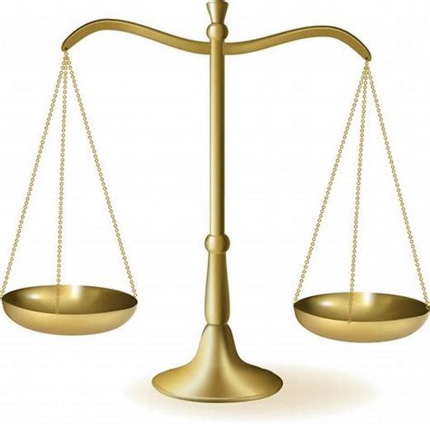
4. The Purpose of the Sermon on the Mount
the way of Christ
vs.
the way of the Pharisees

Slide 15
5. The Possibility of living the Sermon on the Mount
“Behold, the virgin shall conceive and bear a son, and they shall call his name Immanuel”
(which means, God with us).
Matt 1:23
For where two or three are gathered in my name, there am I among them.
Matt 18:20
Go therefore and make disciples of all nations, baptizing them in the name of the Father and of the Son and of the Holy Spirit, teaching them to observe all that I have commanded you. And behold, I am with you always, to the end of the age. Matt 28:19-20

