Slide 2
Introductions
Matthew 1:1-17

Slide 3
1 The book of the genealogy of Jesus Christ, the son of David, the son of Abraham.
² Abraham was the father of Isaac, and Isaac the father of Jacob, and Jacob the father of Judah and his brothers, ³ and Judah the father of Perez and Zerah by Tamar, and Perez the father of Hezron, and Hezron the father of Ram, ⁴ and Ram the father of Amminadab, and Amminadab the father of Nahshon, and Nahshon the father of Salmon, ⁵ and Salmon the father of Boaz by Rahab, and Boaz the father of Obed by Ruth, and Obed the father of Jesse, ⁶ and Jesse the father of David the king.
Matthew 1:1-6

Slide 4
And David was the father of Solomon by the wife of Uriah, ⁷ and Solomon the father of Rehoboam, and Rehoboam the father of Abijah, and Abijah the father of Asaph, ⁸ and Asaph the father of Jehoshaphat, and Jehoshaphat the father of Joram, and Joram the father of Uzziah, ⁹ and Uzziah the father of Jotham, and Jotham the father of Ahaz, and Ahaz the father of Hezekiah, ¹⁰ and Hezekiah the father of Manasseh, and Manasseh the father of Amos, and Amos the father of Josiah, ¹¹ and Josiah the father of Jechoniah and his brothers, at the time of the deportation to Babylon.
Matthew 1:6-11

Slide 5
¹² And after the deportation to Babylon: Jechoniah was the father of Shealtiel, and Shealtiel the father of Zerubbabel, ¹³ and Zerubbabel the father of Abiud, and Abiud the father of Eliakim, and Eliakim the father of Azor, ¹⁴ and Azor the father of Zadok, and Zadok the father of Achim, and Achim the father of Eliud, ¹⁵ and Eliud the father of Eleazar, and Eleazar the father of Matthan, and Matthan the father of Jacob, ¹⁶ and Jacob the father of Joseph the husband of Mary, of whom Jesus was born, who is called Christ.
Matthew 1:12-16

Slide 6
¹⁷ So all the generations from Abraham to David were fourteen generations, and from David to the deportation to Babylon fourteen generations, and from the deportation to Babylon to the Christ fourteen generations.
Matthew 1:17

Slide 8
Abraham

Slide 9
Isaac

Slide 10
Jacob

Slide 11
David

Slide 12
Solomon

Slide 14
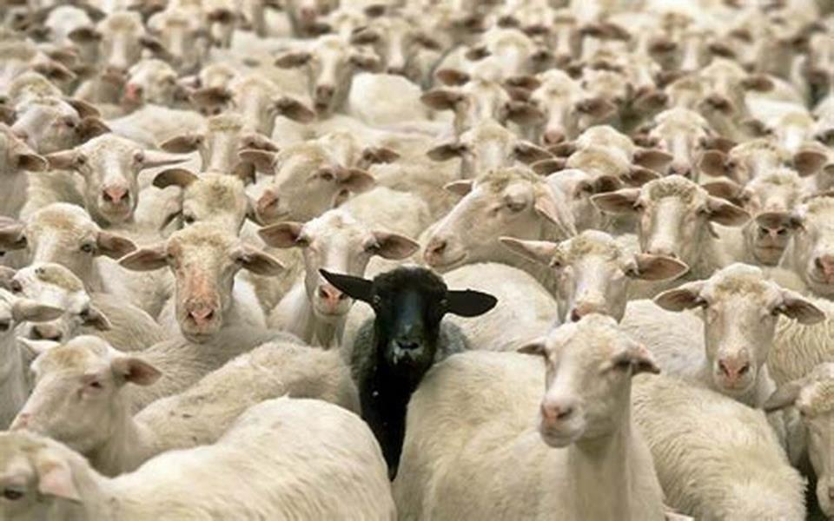

Slide 16
Tamar
³ and Judah the father of Perez and Zerah by Tamar, and Perez the father of Hezron, and Hezron the father of Ram
Matthew 1:3

Slide 17
Rahab
⁵ and Salmon the father of Boaz by Rahab, and Boaz the father of Obed by Ruth, and Obed the father of Jesse Matthew 1:5

Slide 18
Ruth
⁵ and Salmon the father of Boaz by Rahab, and Boaz the father of Obed by Ruth, and Obed the father of Jesse Matthew 1:5

Slide 19
Bathsheba
⁶ and Jesse the father of David the king. And David was the father of Solomon by the wife of Uriah Matthew 1:6

Slide 21
¹⁹ Go therefore and make disciples of all nations, baptizing them in the name of the Father and of the Son and of the Holy Spirit, ²⁰ teaching them to observe all that I have commanded you. And behold, I am with you always, to the end of the age.
Matthew 28:19-20

