Slide 3
Leaving Captivity

Slide 5
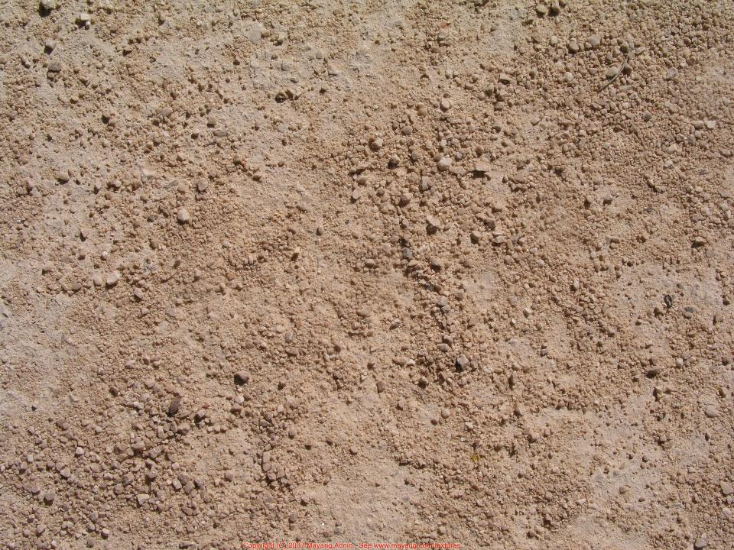
¹⁴ The Lord said to Abram, after Lot had separated from him, “Lift up your eyes and look from the place where you are, northward and southward and eastward and westward, ¹⁵ for all the land that you see I will give to you and to your offspring forever. ¹⁶ I will make your offspring as the dust of the earth, so that if one can count the dust of the earth, your offspring also can be counted.
Gen 13:14-16

Slide 6
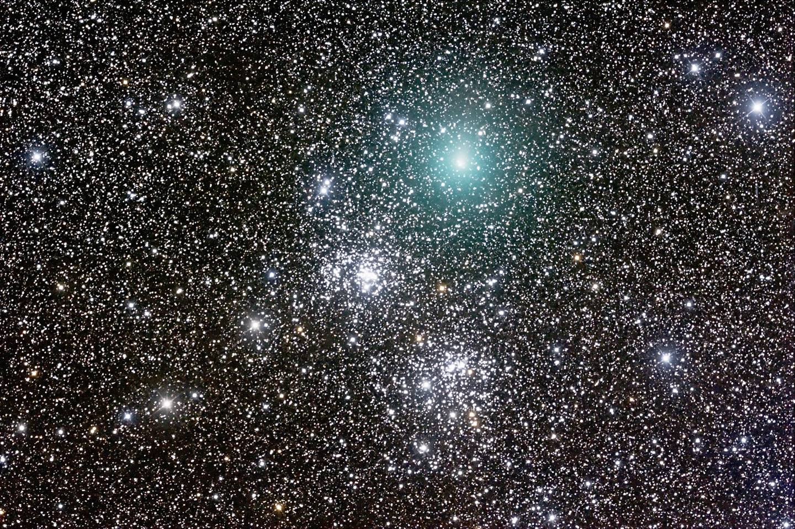
And he brought him outside and said, “Look toward heaven, and number the stars, if you are able to number them.” Then he said to him, “So shall your offspring be.”
Gen 15:5

Slide 7
¹⁷ I will surely bless you, and I will surely multiply your offspring as the stars of heaven and as the sand that is on the seashore. And your offspring shall possess the gate of his enemies, ¹⁸ and in your offspring shall all the nations of the earth be blessed, because you have obeyed my voice. Gen 22:17-18

Slide 9
⁶ Then Joseph died, and all his brothers and all that generation. ⁷ But the people of Israel were fruitful and increased greatly; they multiplied and grew exceedingly strong, so that the land was filled with them.
Exodus 1:6-7

Slide 10
⁸ Now there arose a new king over Egypt, who did not know Joseph. ⁹ And he said to his people, “Behold, the people of Israel are too many and too mighty for us. ¹⁰ Come, let us deal shrewdly with them, lest they multiply, and, if war breaks out, they join our enemies and fight against us and escape from the land.” Exodus 1:8-10

Slide 11
But the more they were oppressed, the more they multiplied and the more they spread abroad. And the Egyptians were in dread of the people of Israel.
Exodus 1:12

Slide 12
So God dealt well with the midwives. And the people multiplied and grew very strong.
Exodus 1:20

Slide 14
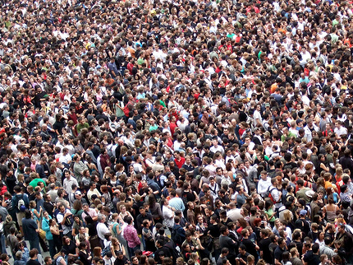

Slide 15
And Joseph said to his brothers, “I am about to die, but God will visit you and bring you up out of this land to the land that he swore to Abraham, to Isaac, and to Jacob.”
Gen 50:24

Slide 17
“she took for him an ark” Exodus 2:3
King James Version
American Standard Version
English Revised Version
Young’s Literal Translation

Slide 18
²³ During those many days the king of Egypt died, and the people of Israel groaned because of their slavery and cried out for help. Their cry for rescue from slavery came up to God. ²⁴ And God heard their groaning, and God remembered his covenant with Abraham, with Isaac, and with Jacob. ²⁵ God saw the people of Israel—and God knew.
Exodus 2:23-25
…I have come down to deliver them out of the hand of the Egyptians and to bring them up out of that land to a good and broad land, a land flowing with milk and honey…
Exodus 3:8

Slide 19
The Pharaoh commanded all his people, “Every son that is born to the Hebrews you shall cast into the Nile…”
^{Exodus 1:22}
Pharaoh's chariots and his host he cast into the sea…
Exodus 15:4

Slide 20
Jesus answered them, “Truly, truly, I say to you, everyone who practices sin is a slave to sin. John 8:34
But thanks be to God, that you who were once slaves of sin have become obedient from the heart to the standard of teaching to which you were committed, and, having been set free from sin, have become slaves of righteousness. Romans 6:17-18

Slide 21
For I do not want you to be unaware, brothers, that our fathers were all under the cloud, and all passed through the sea, and all were baptized into Moses in the cloud and in the sea
1 Cor 10:1-2

Slide 22
⁷ Therefore, as the Holy Spirit says,
“Today, if you hear his voice, ⁸ do not harden your hearts as in the rebellion, on the day of testing in the wilderness, ⁹ where your fathers put me to the test and saw my works for forty years. ¹⁰ Therefore I was provoked with that generation, and said, ‘They always go astray in their heart; they have not known my ways.’ ¹¹ As I swore in my wrath, ‘They shall not enter my rest.’”
¹² Take care, brothers, lest there be in any of you an evil, unbelieving heart, leading you to fall away from the living God. Heb 3:7-12

Slide 23
Leaving Captivity

