Slide 3
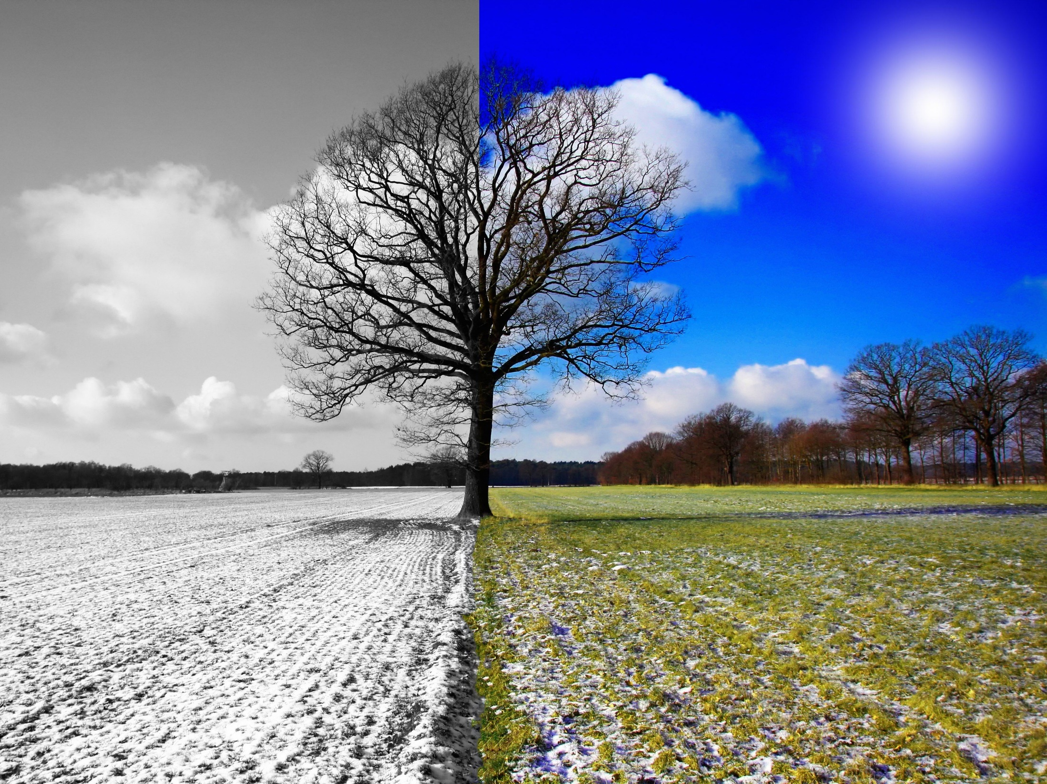
From
Babel
Barrenness
&
to
Blessings

Slide 4
And as people migrated from the east, they found a plain in the land of Shinar and settled there. Gen 11:2

Slide 5
And they said to one another, “Come, let us make bricks, and burn them thoroughly.” And they had brick for stone, and bitumen for mortar. .Gen 11:3

Slide 6
Then they said, “Come, let us build ourselves a city and a tower with its top in the heavens, and let us make a name for ourselves, lest we be dispersed over the face of the whole earth.” Gen 11:4

Slide 7
Come, let us go down and there confuse their language, so that they may not understand one another's speech.” So the Lord dispersed them from there over the face of all the earth, and they left off building the city. Therefore its name was called Babel, because there the Lord confused the language of all the earth. And from there the Lord dispersed them over the face of all the earth. Gen 11:7-9

Slide 8
Come, let us go down and there confuse their language, so that they may not understand one another's speech.” So the Lord dispersed them from there over the face of all the earth, and they left off building the city. Therefore its name was called Babel, because there the Lord confused the language of all the earth. And from there the Lord dispersed them over the face of all the earth. Gen 11:7-9

Slide 9
Come, let us go down and there confuse their language, so that they may not understand one another's speech.” So the Lord dispersed them from there over the face of all the earth, and they left off building the city. Therefore its name was called Babel, because there the Lord confused the language of all the earth. And from there the Lord dispersed them over the face of all the earth. Gen 11:7-9

Slide 10
Come, let us go down and there confuse their language, so that they may not understand one another's speech.” So the Lord dispersed them from there over the face of all the earth, and they left off building the city. Therefore its name was called Babel, because there the Lord confused the language of all the earth. And from there the Lord dispersed them over the face of all the earth. Gen 11:7-9

Slide 11
Now Sarai was barren; she had no child
Gen 11:30.

Slide 12
Now the Lord said to Abram, “Go from your country and your kindred and your father's house to the land that I will show you. And I will make of you a great nation, and I will bless you and make your name great, so that you will be a blessing. I will bless those who bless you, and him who dishonors you I will curse, and in you all the families of the earth shall be blessed.” Gen 12:1-3

Slide 13
Now the Lord said to Abram, “Go from your country and your kindred and your father's house to the land that I will show you. And I will make of you a great nation, and I will bless you and make your name great, so that you will be a blessing. I will bless those who bless you, and him who dishonors you I will curse, and in you all the families of the earth shall be blessed.” Gen 12:1-3

Slide 14
Now the Lord said to Abram, “Go from your country and your kindred and your father's house to the land that I will show you. And I will make of you a great nation, and I will bless you and make your name great, so that you will be a blessing. I will bless those who bless you, and him who dishonors you I will curse, and in you all the families of the earth shall be blessed.” Gen 12:1-3

Slide 15
Now the Lord said to Abram, “Go from your country and your kindred and your father's house to the land that I will show you. And I will make of you a great nation, and I will bless you and make your name great, so that you will be a blessing. I will bless those who bless you, and him who dishonors you I will curse, and in you all the families of the earth shall be blessed.” Gen 12:1-3

Slide 16
Now the Lord said to Abram, “Go from your country and your kindred and your father's house to the land that I will show you. And I will make of you a great nation, and I will bless you and make your name great, so that you will be a blessing. I will bless those who bless you, and him who dishonors you I will curse, and in you all the families of the earth shall be blessed.” Gen 12:1-3

Slide 17
So Abram went…
Gen 12:4

Slide 18
By faith Abraham obeyed when he was called to go out to a place that he was to receive as an inheritance. And he went out, not knowing where he was going. By faith he went to live in the land of promise, as in a foreign land, living in tents with Isaac and Jacob, heirs with him of the same promise. For he was looking forward to the city that has foundations, whose designer and builder is God. Heb 11:8-10

Slide 19
In hope he believed against hope, that he should become the father of many nations, as he had been told, “So shall your offspring be.” He did not weaken in faith when he considered his own body, which was as good as dead (since he was about a hundred years old), or when he considered the barrenness of Sarah's womb. No unbelief made him waver concerning the promise of God, but he grew strong in his faith as he gave glory to God, fully convinced that God was able to do what he had promised. Rom 4:18-21

Slide 20
as it is written, “I have made you the father of many nations”—in the presence of the God in whom he believed,
who gives life to the dead
and
calls into existence the things that do not exist. Rom 4:17
1)
2)

Slide 21
He did not weaken in faith when he considered his own body, which was as good as dead (since he was about a hundred years old), or when he considered the barrenness of Sarah's womb.
Rom 4:19
Therefore from one man, and him as good as dead, were born descendants as many as the stars of heaven and as many as the innumerable grains of sand by the seashore. Heb 11:12

Slide 22
And you were dead in the trespasses and sins in which you once walked, following the course of this world, following the prince of the power of the air, the spirit that is now at work in the sons of disobedience…But God, being rich in mercy, because of the great love with which he loved us, even when we were dead in our trespasses, made us alive together with Christ—by grace you have been saved Eph 2:1-2, 4-5

Slide 23
And you were dead in the trespasses and sins in which you once walked, following the course of this world, following the prince of the power of the air, the spirit that is now at work in the sons of disobedience…But God, being rich in mercy, because of the great love with which he loved us, even when we were dead in our trespasses, made us alive together with Christ—by grace you have been saved Eph 2:1-2, 4-5

Slide 24
as it is written, “I have made you the father of many nations”—in the presence of the God in whom he believed,
who gives life to the dead
and
calls into existence the things that do not exist. Rom 4:17
1)
2)

Slide 25
From
Babel
Barrenness
&
to
Blessings

