Slide 3
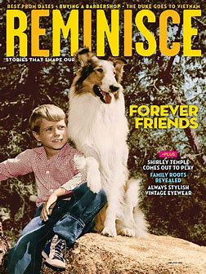

Slide 5
And he who was seated on the throne said, “Behold, I am making all things new.” Also he said, “Write this down, for these words are trustworthy and true.” Rev 21:5

Slide 8
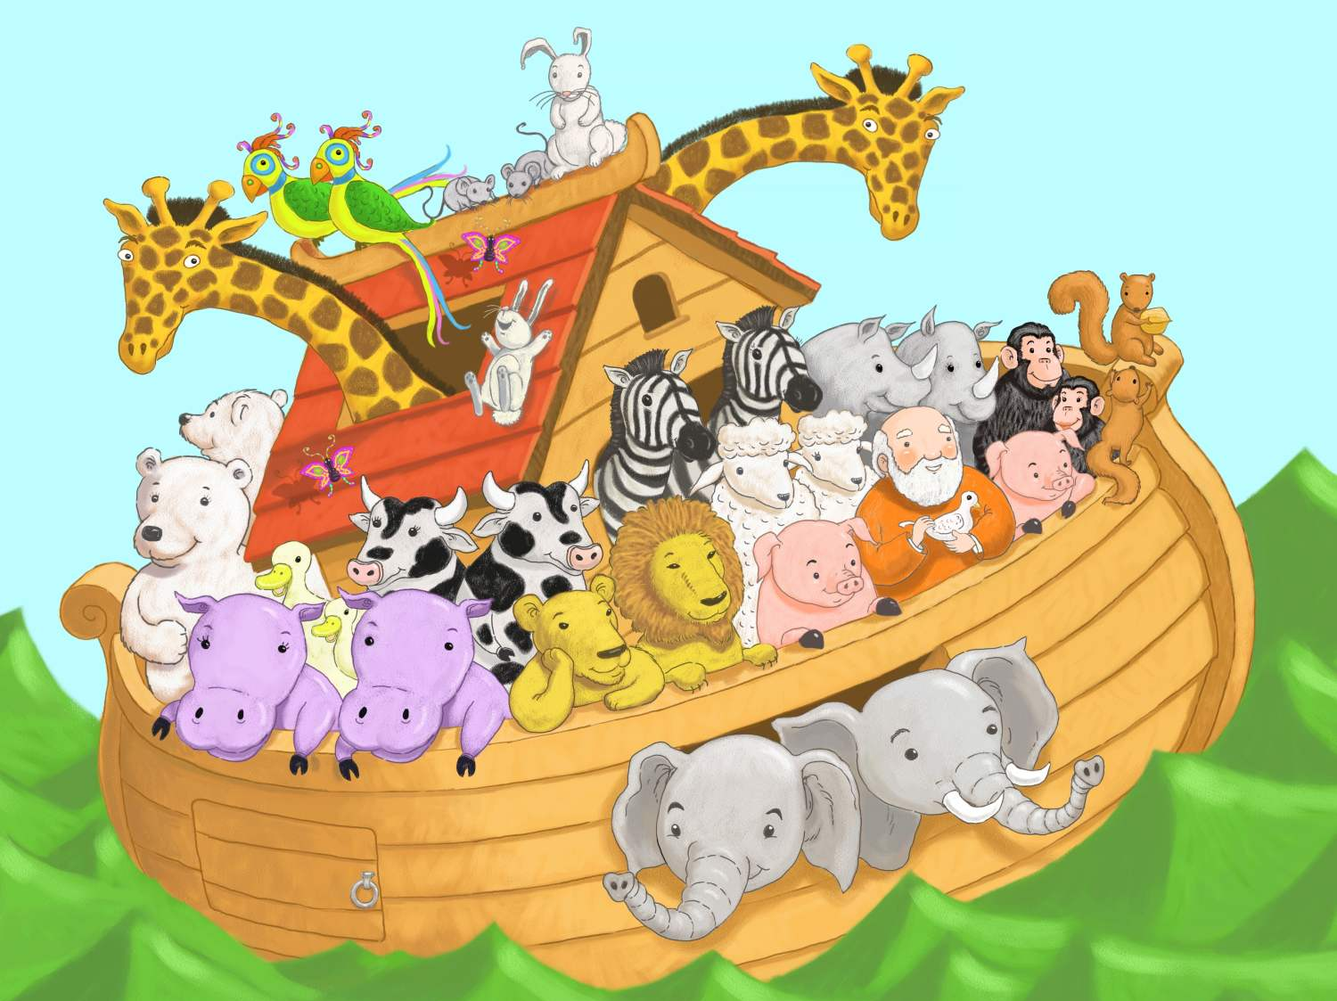

Slide 9
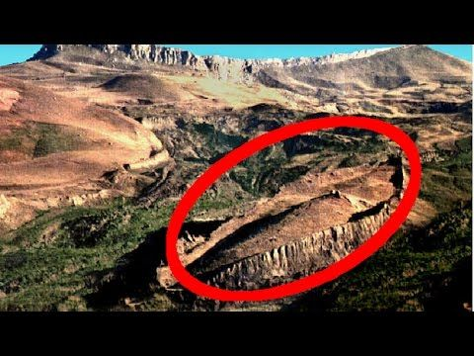

Slide 10
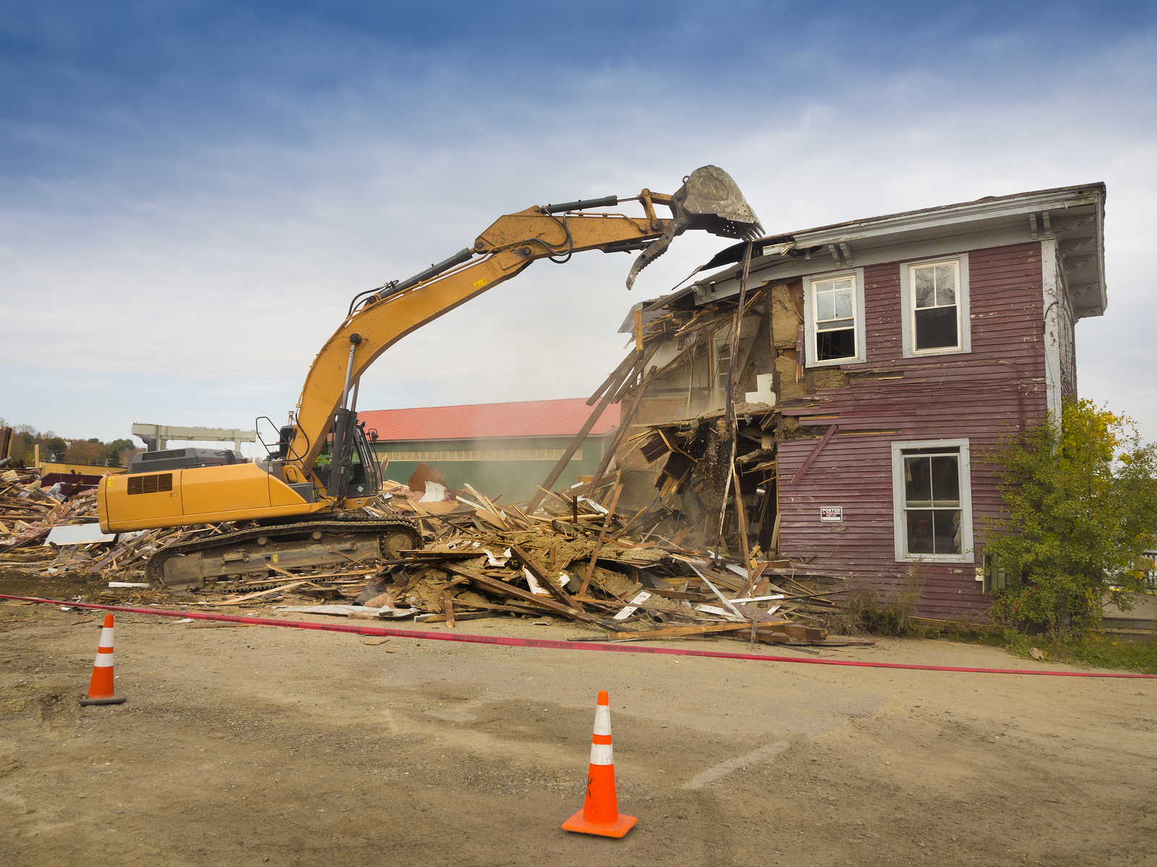

Slide 11
And God saw the earth, and behold, it was corrupt, for all flesh had corrupted their way on the earth. Gen 6:12
And God saw everything that he had made, and behold, it was very good… Gen 1:31

Slide 12
So the Lord said, “I will blot out man whom I have created from the face of the land, man and animals and creeping things and birds of the heavens, for I am sorry that I have made them.”
Gen 6:7

Slide 13
So the Lord said, “I will blot out man whom I have created from the face of the land, man and animals and creeping things and birds of the heavens, for I am sorry that I have made them.”
Gen 6:7

Slide 14
So the Lord said, “I will blot out man whom I have created from the face of the land, man and animals and creeping things and birds of the heavens, for I am sorry that I have made them.”
Gen 6:7
And God said, “Let the waters swarm with swarms of living creatures, and let birds fly above the earth across the expanse of the heavens.” Gen 1:20
And God said, “Let the earth bring forth living creatures according to their kinds—livestock and creeping things and beasts of the earth according to their kinds.” And it was so. Gen 1:24
Then God said, “Let us make man in our image, in our likeness…” Gen 1:27

Slide 15
Everything on the dry land in whose nostrils was the breath of life died. He blotted out every living thing that was on the face of the ground, man and animals and creeping things and birds of the heavens. They were blotted out from the earth. Only Noah was left, and those who were with him in the ark.
Gen 7:22-23

Slide 16
But God remembered Noah and all the beasts and all the livestock that were with him in the ark. And God made a wind blow over the earth, and the waters subsided.
Gen 8:1
God kept Noah in mind, along with all the wildlife and livestock that were with him in the ark. God’s Spirit moved throughout the earth, causing the flood waters to subside. Gen 8:1 ISV
The earth was without form and void, and darkness was over the face of the deep. And the Spirit of God was hovering over the face of the waters.
Gen 1:2

Slide 17
In the six hundred and first year, in the first month, the first day of the month, the waters were dried from off the earth. And Noah removed the covering of the ark and looked, and behold, the face of the ground was dry. In the second month, on the twenty-seventh day of the month, the earth had dried out. Gen 8:13-14
And God said, “Let the waters under the heavens be gathered together into one place, and let the dry land appear.” And it was so. God called the dry land Earth, and the waters that were gathered together he called Seas. And God saw that it was good. Gen 1:9-10

Slide 18
Bring out with you every living thing that is with you of all flesh—birds and animals and every creeping thing that creeps on the earth—that they may swarm on the earth, and be fruitful and multiply on the earth.” Gen 8:17
And God said, “Let the earth bring forth living creatures according to their kinds—livestock and creeping things and beasts of the earth according to their kinds.” And it was so. Gen 1:24

Slide 19
And God blessed Noah and his sons and said to them, “Be fruitful and multiply and fill the earth…
Gen 9:1
And God blessed them. And God said to them, “Be fruitful and multiply and fill the earth…
Gen 1:28

Slide 20
The fear of you and the dread of you shall be upon every beast of the earth and upon every bird of the heavens, upon everything that creeps on the ground and all the fish of the sea. Into your hand they are delivered.
Gen 9:2
…have dominion over the fish of the sea and over the birds of the heavens and over every living thing that moves on the earth.”
Gen 1:28

Slide 22
Blessed be the God and Father of our Lord Jesus Christ! According to his great mercy, he has caused us to be born again to a living hope through the resurrection of Jesus Christ from the dead
1 Pet 1:3
Having purified your souls by your obedience to the truth for a sincere brotherly love, love one another earnestly from a pure heart, since you have been born again, not of perishable seed but of imperishable, through the living and abiding word of God
1 Pet 1:23

Slide 23
Baptism, which corresponds to this, now saves you, not as a removal of dirt from the body but as an appeal to God for a good conscience, through the resurrection of Jesus Christ
1 Pet 3:21

