Slide 2
Blessed Or Wicked?
Psalm 1

Slide 3
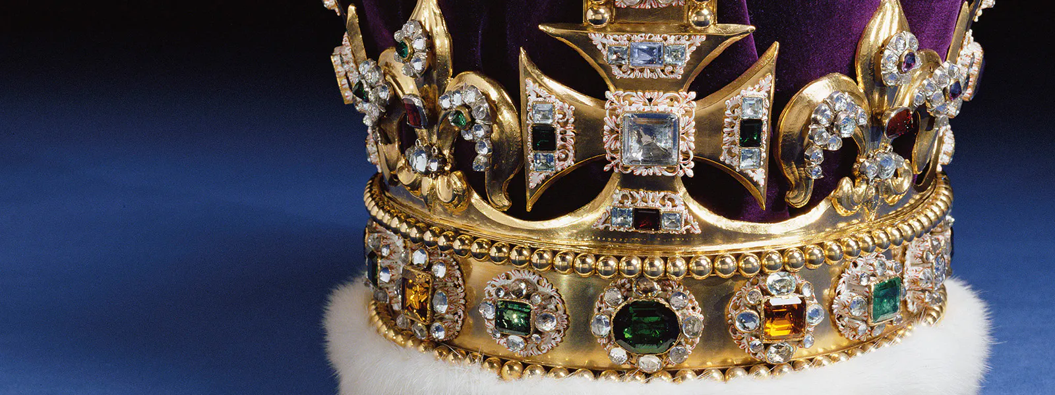
Who is your King?
Psalm 2

Slide 4

Who is your King?
The Psalm in its original context
The Psalm in the New Testament
The Psalm for us today

