Slide 2
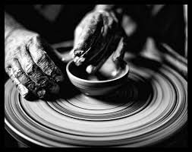
The potter and the clay
JEREMIAH 18:1-6

Slide 3
GOD IS THE POTTER
DEUTERONOMY 6:24
PSALM 139:1-3
PSALM 139:13-16
LUKE 12:6-7

Slide 4
WE ARE THE CLAY
HEBREWS 11:6
I PETER 5:5
JAMES 1:21
MATTHEW 7:21-23

Slide 5
WE ARE MOLDED BY THE LORD’S TEACHING
ROMANS 12:1-2
GALATIONS 4:19
COLOSSIANS 3:9-10

Slide 6
This molding is a process
II PETER 1:5-8
JOHN 5:30

Slide 7
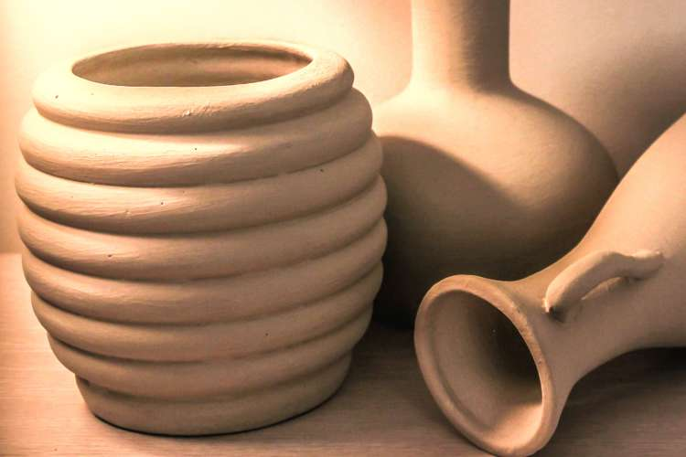
THIS MOLDING HAS A PURPOSE
II TIMOTHY 2:20:21

