Slide 1
“It is in vain, sir, to extenuate the matter. Gentlemen may cry, peace, peace -- but there is no peace. The war is actually begun! The next gale that sweeps from the north will bring to our ears the clash of resounding arms! Our brethren are already in the field! Why stand we here idle? What is it that gentlemen wish? What would they have? Is life so dear, or peace so sweet, as to be purchased at the price of chains and slavery? Forbid it, Almighty God! -- I know not what course others may take; but as for me, give me liberty or give me death!”
Patrick Henry (March 23, 1775)

Slide 2
GIVE ME LIBERTY, OR GIVE ME DEATH

Slide 3
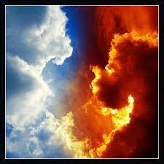
GIVE ME LIBERTY, OR GIVE ME DEATH

Slide 4
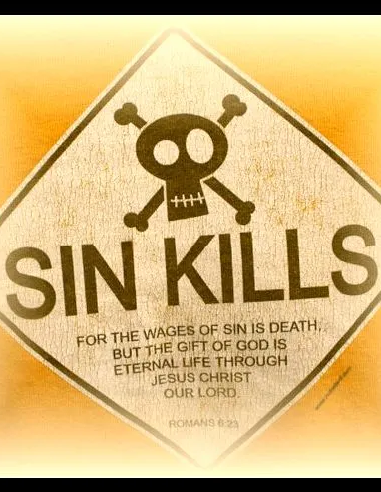
DEATH THROUGH SIN
Romans 3:9-12, 23
Sin is a liar (Rom. 7:11)
I John 2:16- lust of the eyes, lust of the flesh, pride of life
Sin brings death (Rom. 6:23)
Sin will dominate our lives- Romans 7:14-24

Slide 5
LIBERTY- GOD’S GRACE
Our sins have separated us from God (Isaiah 59:2)
Romans 8:1-4
Romans 3:21-26
Ephesians 2:8-9

Slide 6
LIBERTY- SURRENDER
God’s grace is not giving us free will to sin! (Rom. 6:1-2)
God’s grace gives victory over sin
Romans 6:8-19

Slide 7
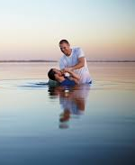
LIBERTY- BAPTISM
We must be in Christ to have freedom from sin (Rom. 8:1)
Romans 6:1-9
We die to sin (vs. 2)
We enter Christ (vs. 3)
We enter into his death (vs. 3)
We are raised to walk in newness of life (vs. 4)
Our old self was crucified (vs. 6)
We are freed from sin (vs. 7)
Death no longer has dominion over us (vs. 9)

