Slide 2

Before We Can Worship Correctly
Matthew 5:21-26

Slide 3
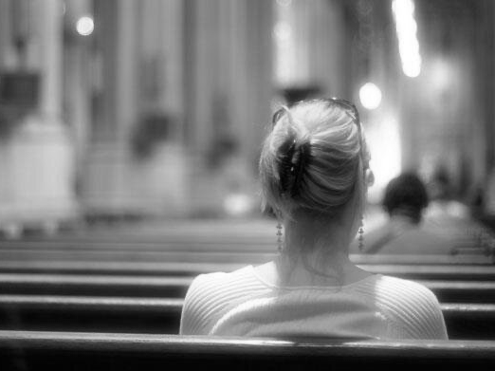
Matthew 5:19
Therefore, whoever relaxes one of the least of these commandments and teaches others to do the same will be called least in the kingdom of heaven, but whoever does them and teaches them will be called great in the kingdom of heaven

Slide 4
Matthew 5:17-18
¹⁷ “Do not think that I have come to abolish the Law or the Prophets; I have not come to abolish them but to fulfill them.
¹⁸ For truly, I say to you, until heaven and earth pass away, not an iota, not a dot, will pass from the Law until all is accomplished

Slide 5
Matthew 5:20
For I tell you, unless your righteousness exceeds that of the scribes and Pharisees, you will never enter the kingdom of heaven.

Slide 6
Matthew 7:13-14
¹³ “Enter by the narrow gate. For the gate is wide and the way is easy that leads to destruction, and those who enter by it are many.
¹⁴ For the gate is narrow and the way is hard that leads to life, and those who find it are few.

Slide 7
Matthew 7:15-20
¹⁵ “Beware of false prophets, who come to you in sheep’s clothing but inwardly are ravenous wolves.
¹⁶ You will recognize them by their fruits. Are grapes gathered from thornbushes, or figs from thistles?
¹⁷ So, every healthy tree bears good fruit, but the diseased tree bears bad fruit.
¹⁸ A healthy tree cannot bear bad fruit, nor can a diseased tree bear good fruit.
¹⁹ Every tree that does not bear good fruit is cut down and thrown into the fire.
²⁰ Thus you will recognize them by their fruits.

Slide 8
Matthew 7:21-23
²¹ “Not everyone who says to me, ‘Lord, Lord,’ will enter the kingdom of heaven, but the one who does the will of my Father who is in heaven.
²² On that day many will say to me, ‘Lord, Lord, did we not prophesy in your name, and cast out demons in your name, and do many mighty works in your name?’
²³ And then will I declare to them, ‘I never knew you; depart from me, you workers of lawlessness.’

Slide 9
Matthew 7:24-27
²⁴ “Everyone then who hears these words of mine and does them will be like a wise man who built his house on the rock.
²⁵ And the rain fell, and the floods came, and the winds blew and beat on that house, but it did not fall, because it had been founded on the rock.
²⁶ And everyone who hears these words of mine and does not do them will be like a foolish man who built his house on the sand.
²⁷ And the rain fell, and the floods came, and the winds blew and beat against that house, and it fell, and great was the fall of it.”

Slide 10
Matthew 5:21-22
²¹ “You have heard that it was said to those of old, ‘You shall not murder; and whoever murders will be liable to judgment.’
²² But I say to you that everyone who is angry with his brother will be liable to judgment; whoever insults his brother will be liable to the council; and whoever says, ‘You fool!’ will be liable to the hell of fire.

Slide 11
Matthew 5:23-25
²³ So if you are offering your gift at the altar and there remember that your brother has something against you,
²⁴ leave your gift there before the altar and go. First be reconciled to your brother, and then come and offer your gift.
²⁵ Come to terms quickly with your accuser while you are going with him to court, lest your accuser hand you over to the judge, and the judge to the guard, and you be put in prison.

