Slide 2
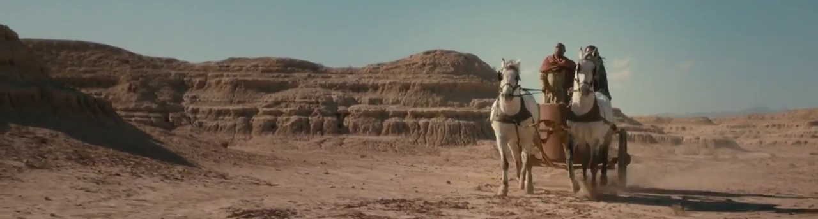
Lesson’s From the Ethiopian Eunuch
You can be religious, yet still lost (vs.27-28)
The importance of being open to learning (vs. 29-34)
We learn what it means to preach Jesus (vs. 35)
How we are to be baptized (vs. 38-39)

Slide 3

“WHAT HINDERS ME FROM BEING BAPTIZED?”
ACTS 8:36

Slide 4
WHAT DOES HINDER?
LACK OF WATER
LACK OF FAITH
LACK OF REPENTANCE

Slide 5
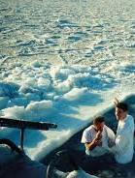
WHAT SHOULD NOT HINDER US
PRIDE
FAMILY
PEER PRESSURE
LACK UNDERSTANDING
TIME OF DAY

