Slide 1


Slide 2
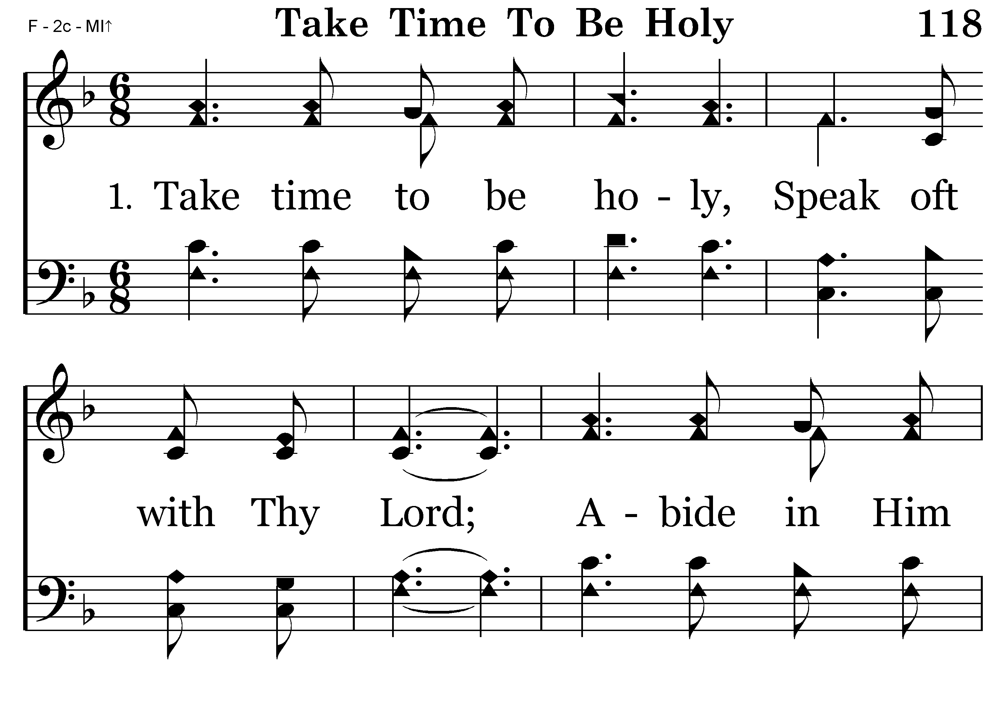

Slide 3
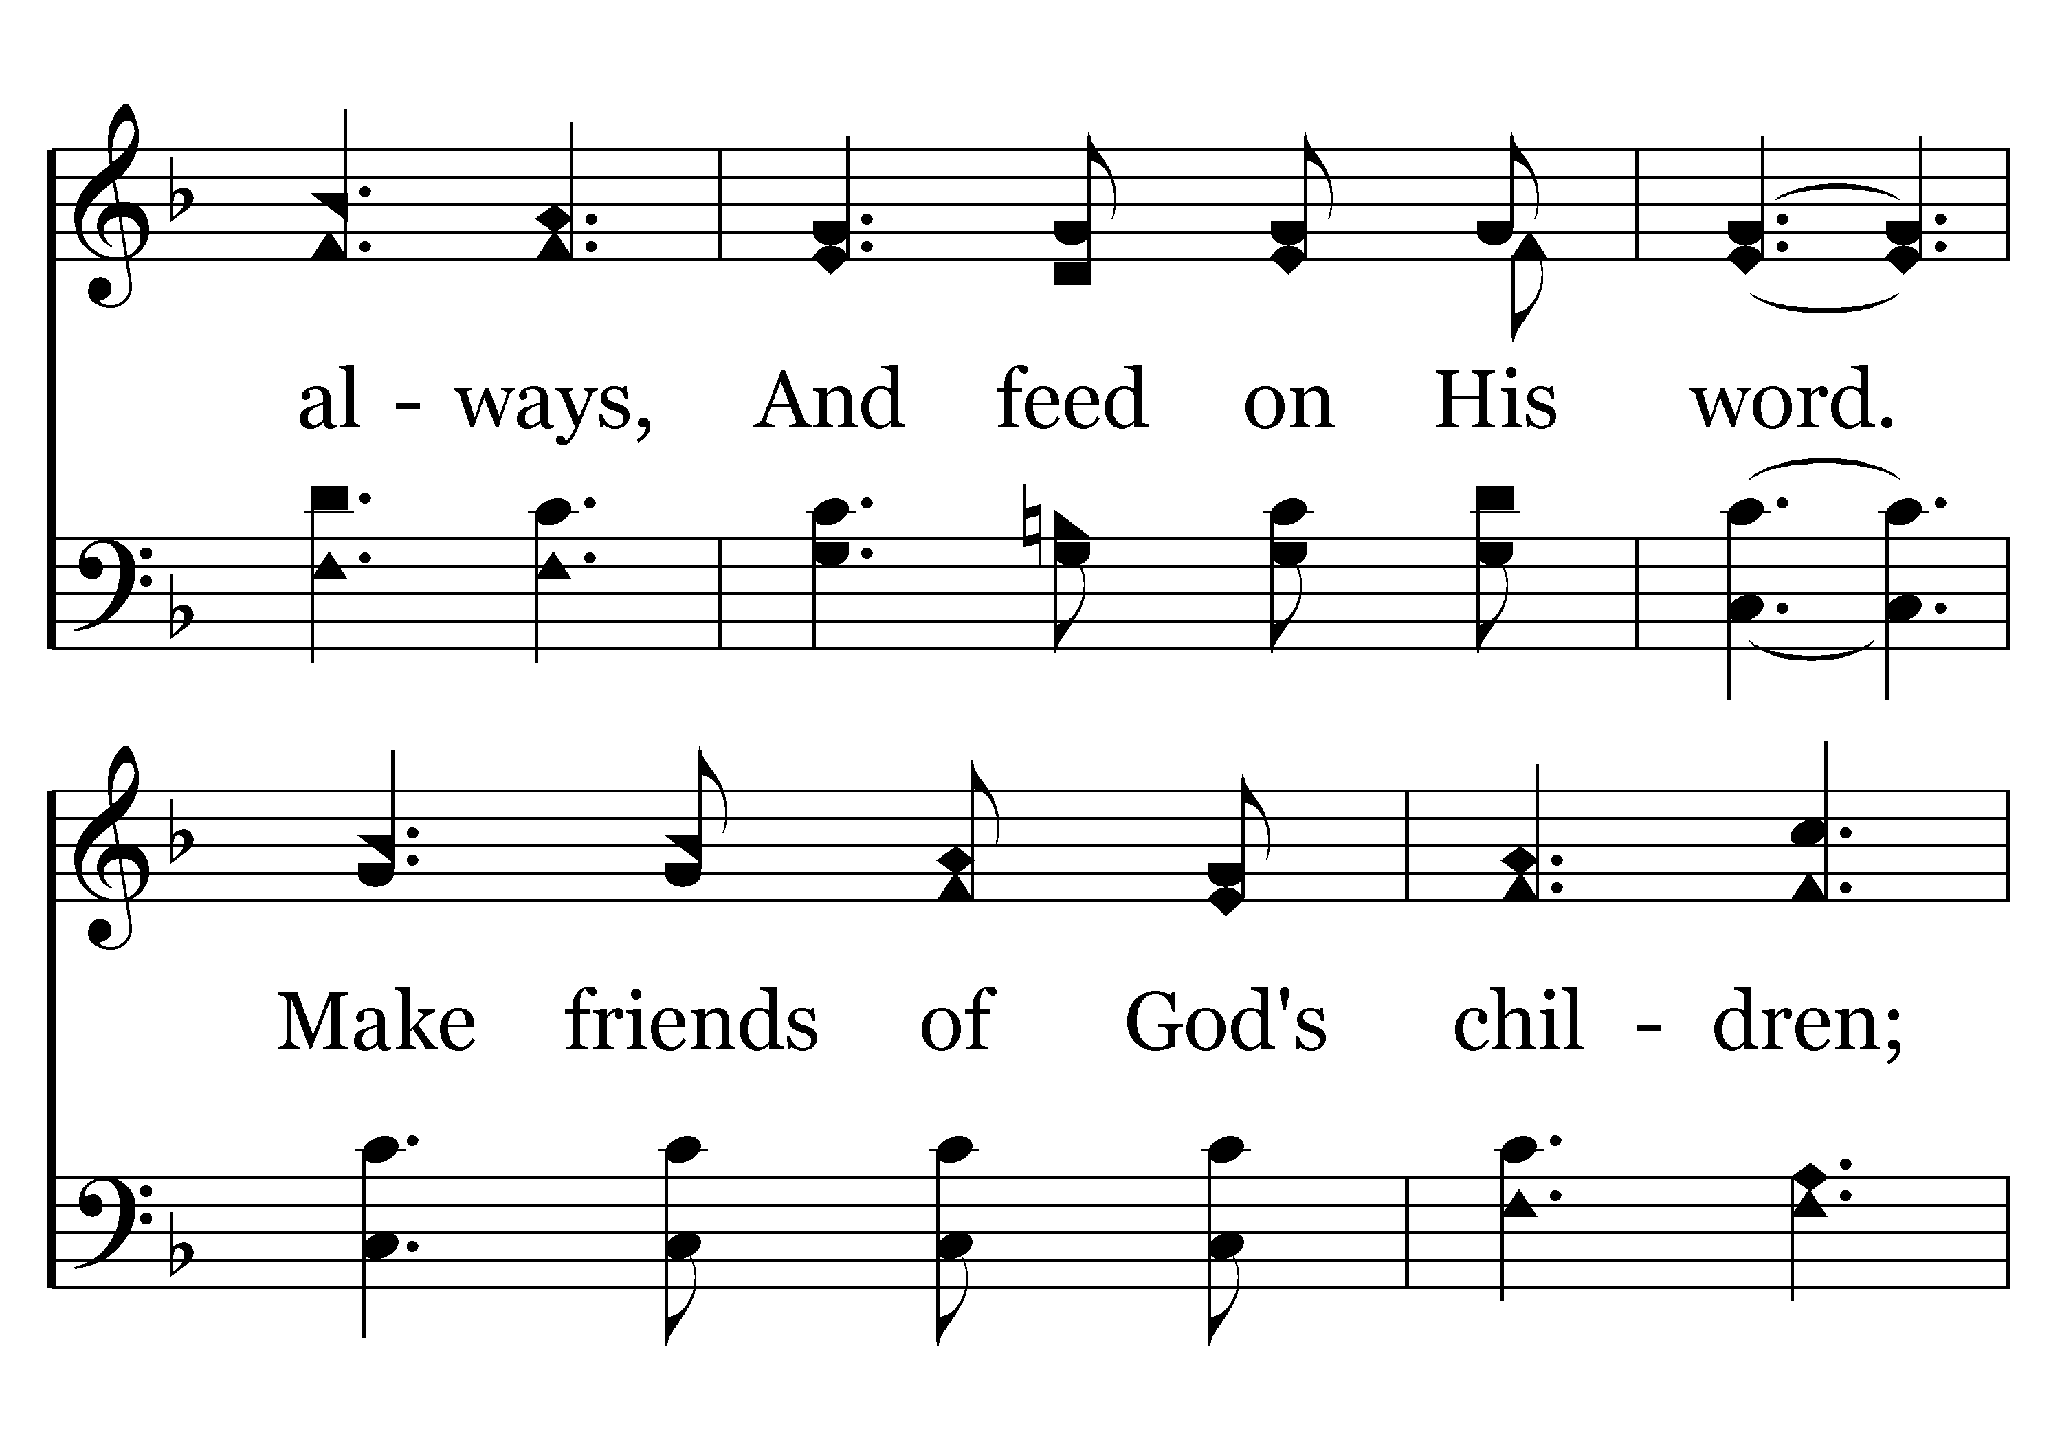
118 - Take Time To Be Holy - 1.2

Slide 4
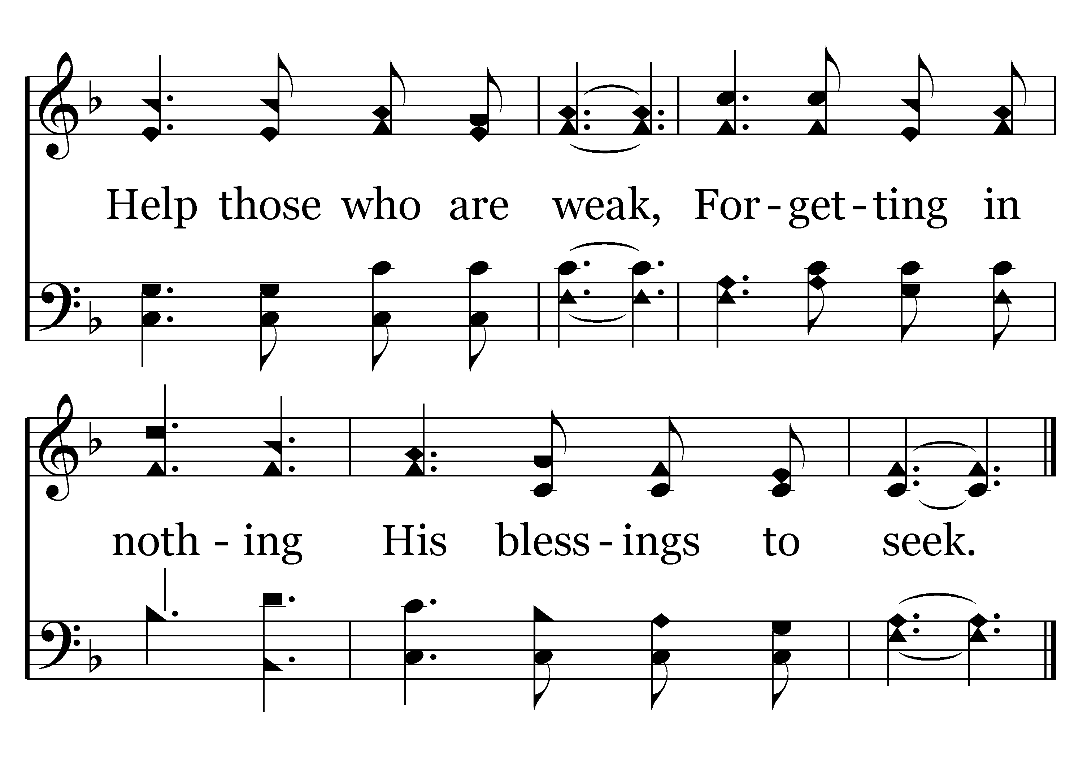
118 - Take Time To Be Holy - 1.3
End of Verse 1

Slide 5

Make Time To Be Holy
Pursue activities that feed holiness (Gal. 6:7-8)
Communication with God is essential to holiness (I Thess. 5:16-23)
Holiness doesn’t happen on accident!

Slide 6
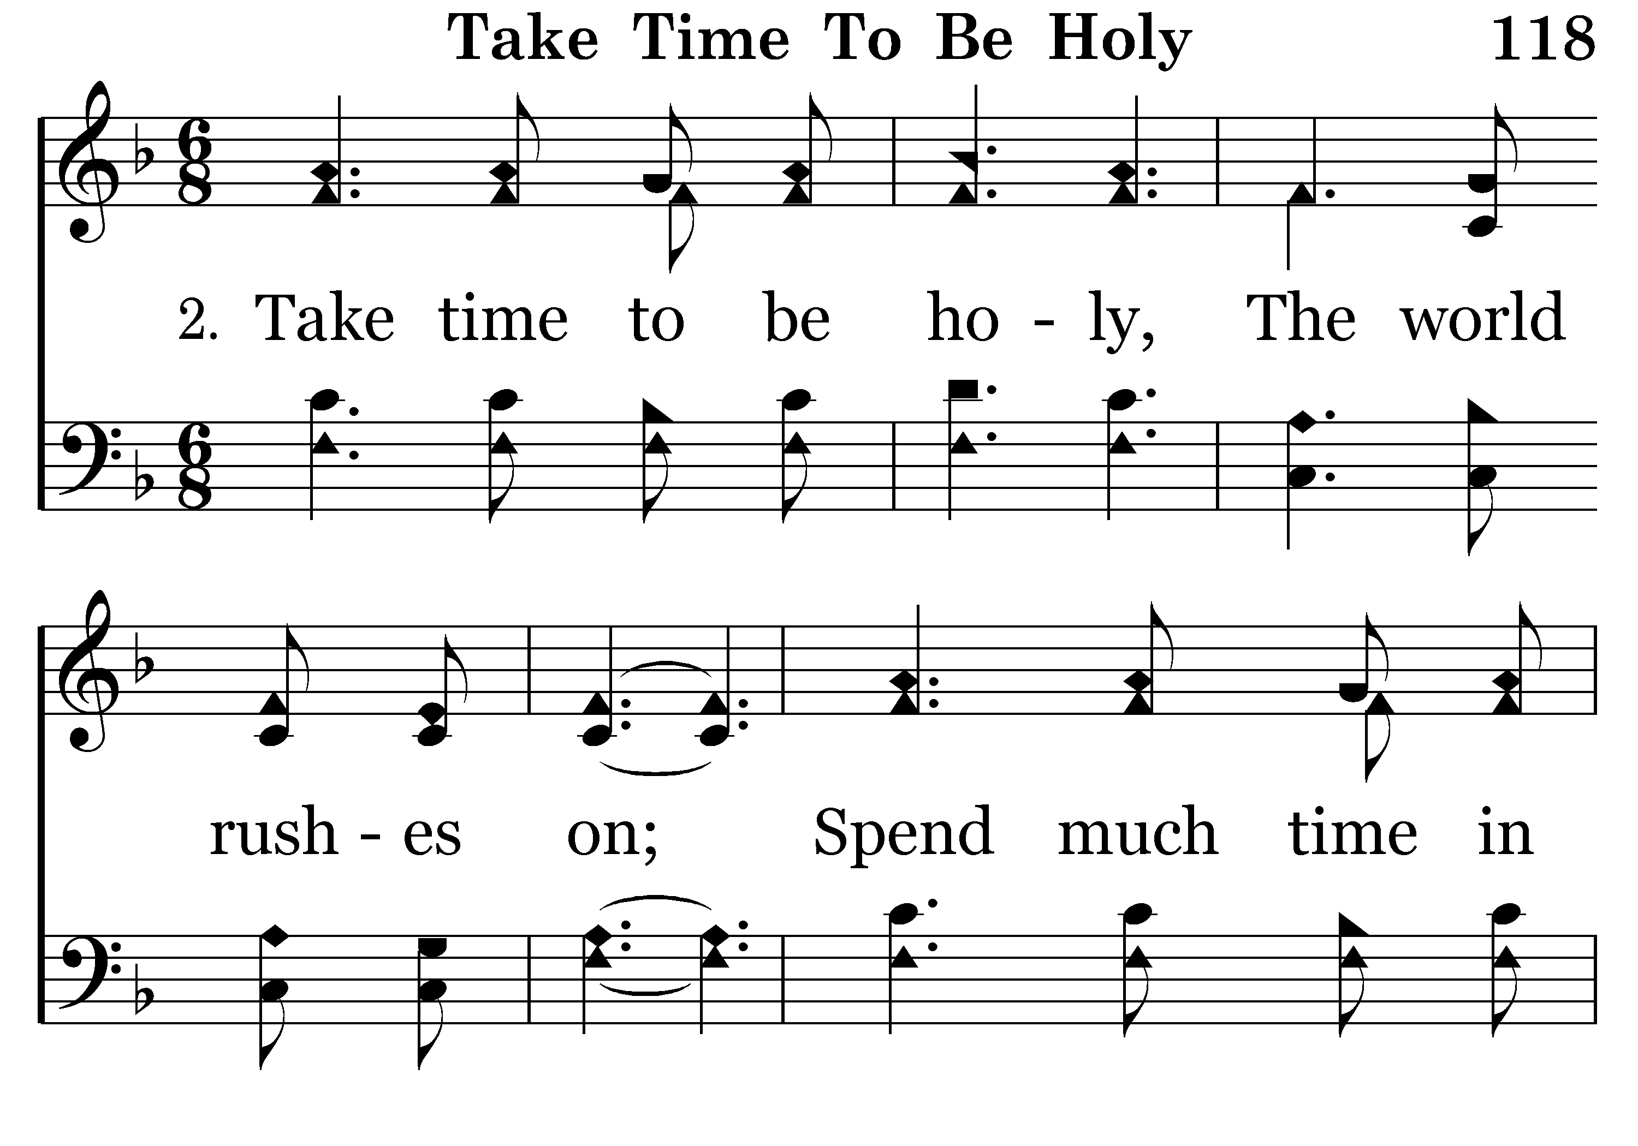

Slide 7
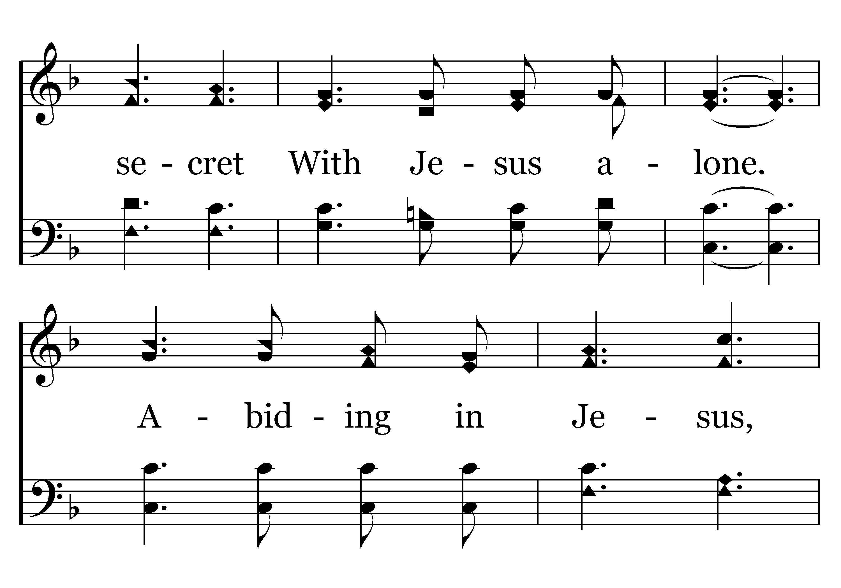
118 - Take Time To Be Holy - 2.2

Slide 8
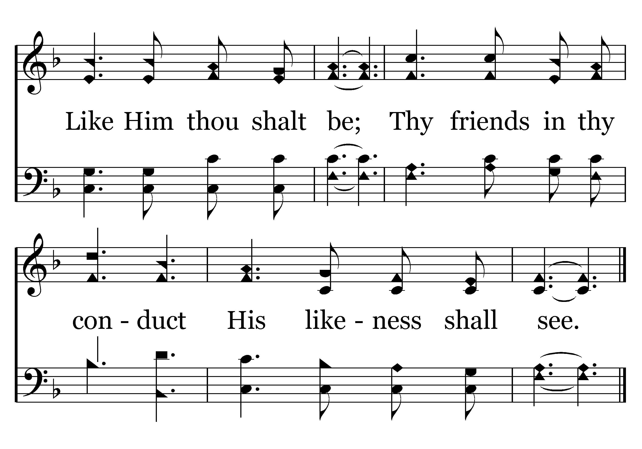
118 - Take Time To Be Holy - 2.3
End of Verse 2

Slide 9

Slow Down To Be Holy
We live in a frantic world
Being too busy can be detrimental to holiness
We need to slow down (Phil. 4:8)
Consider the importance of prayer and bible study
  II Tim. 3:16-17; I Thess. 5:17; James 5:13-16

Slide 10
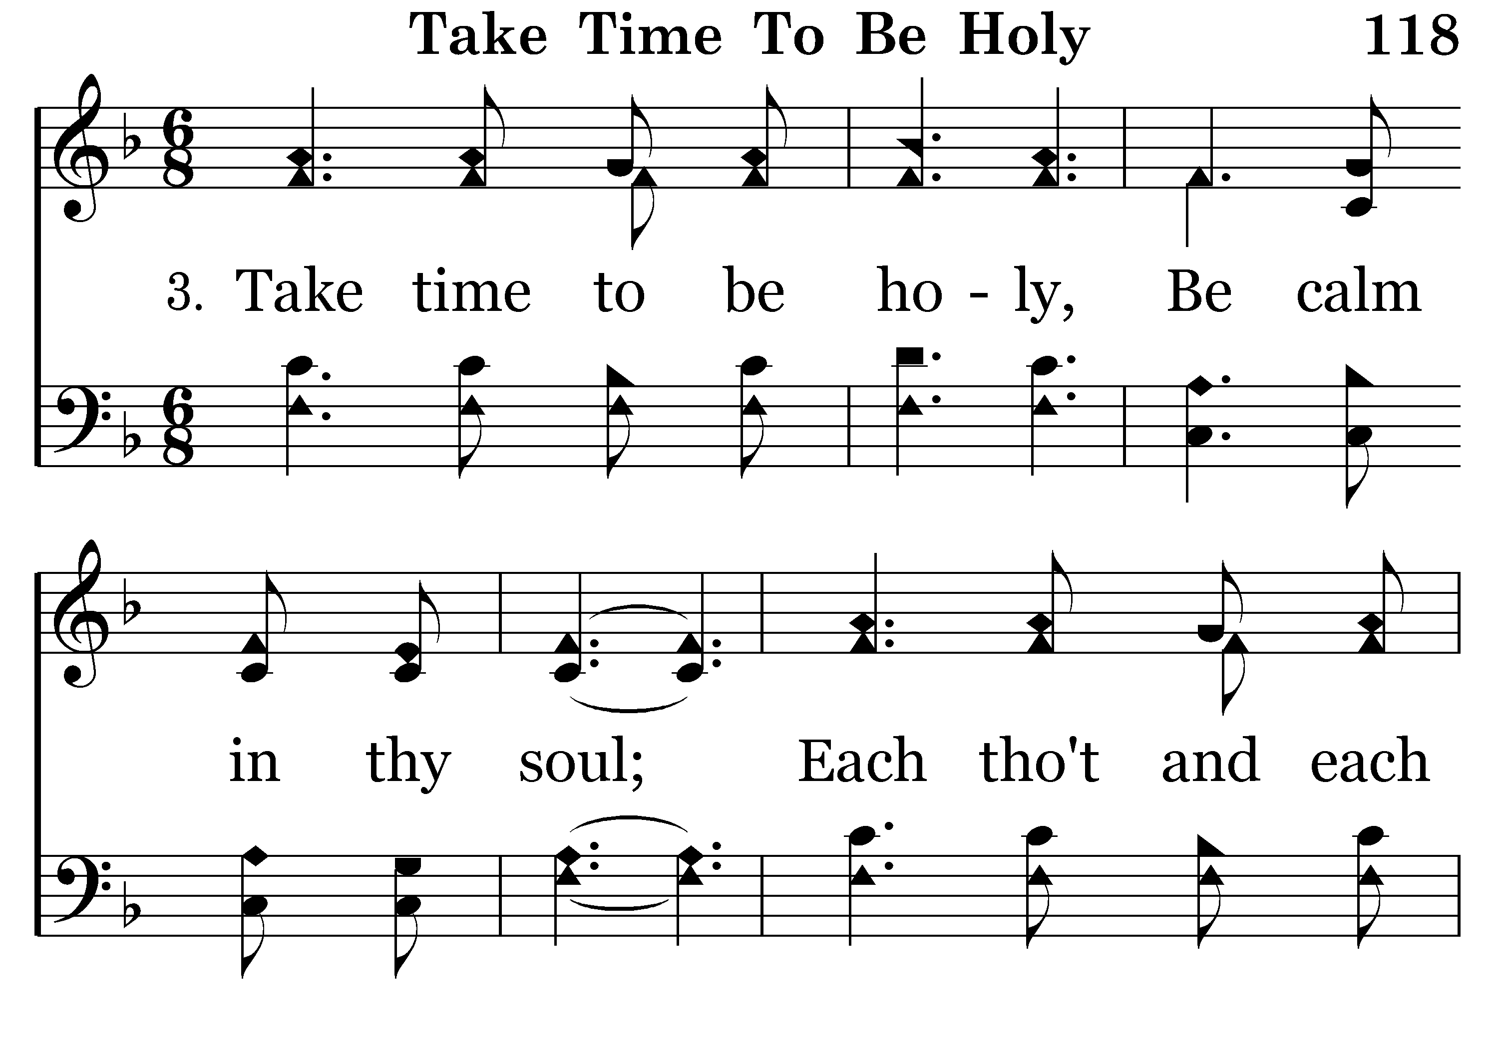

Slide 11
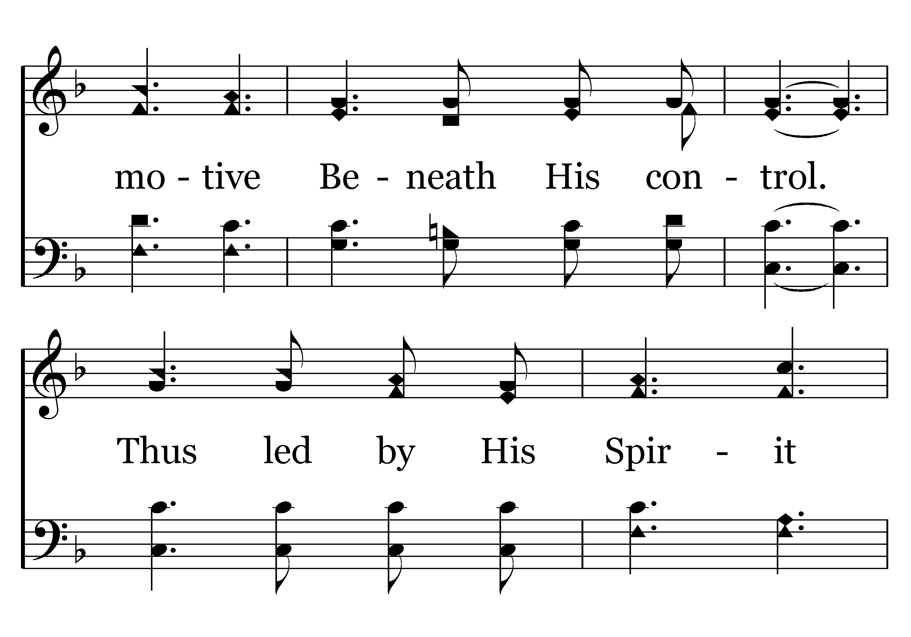
118 - Take Time To Be Holy - 3.2

Slide 12
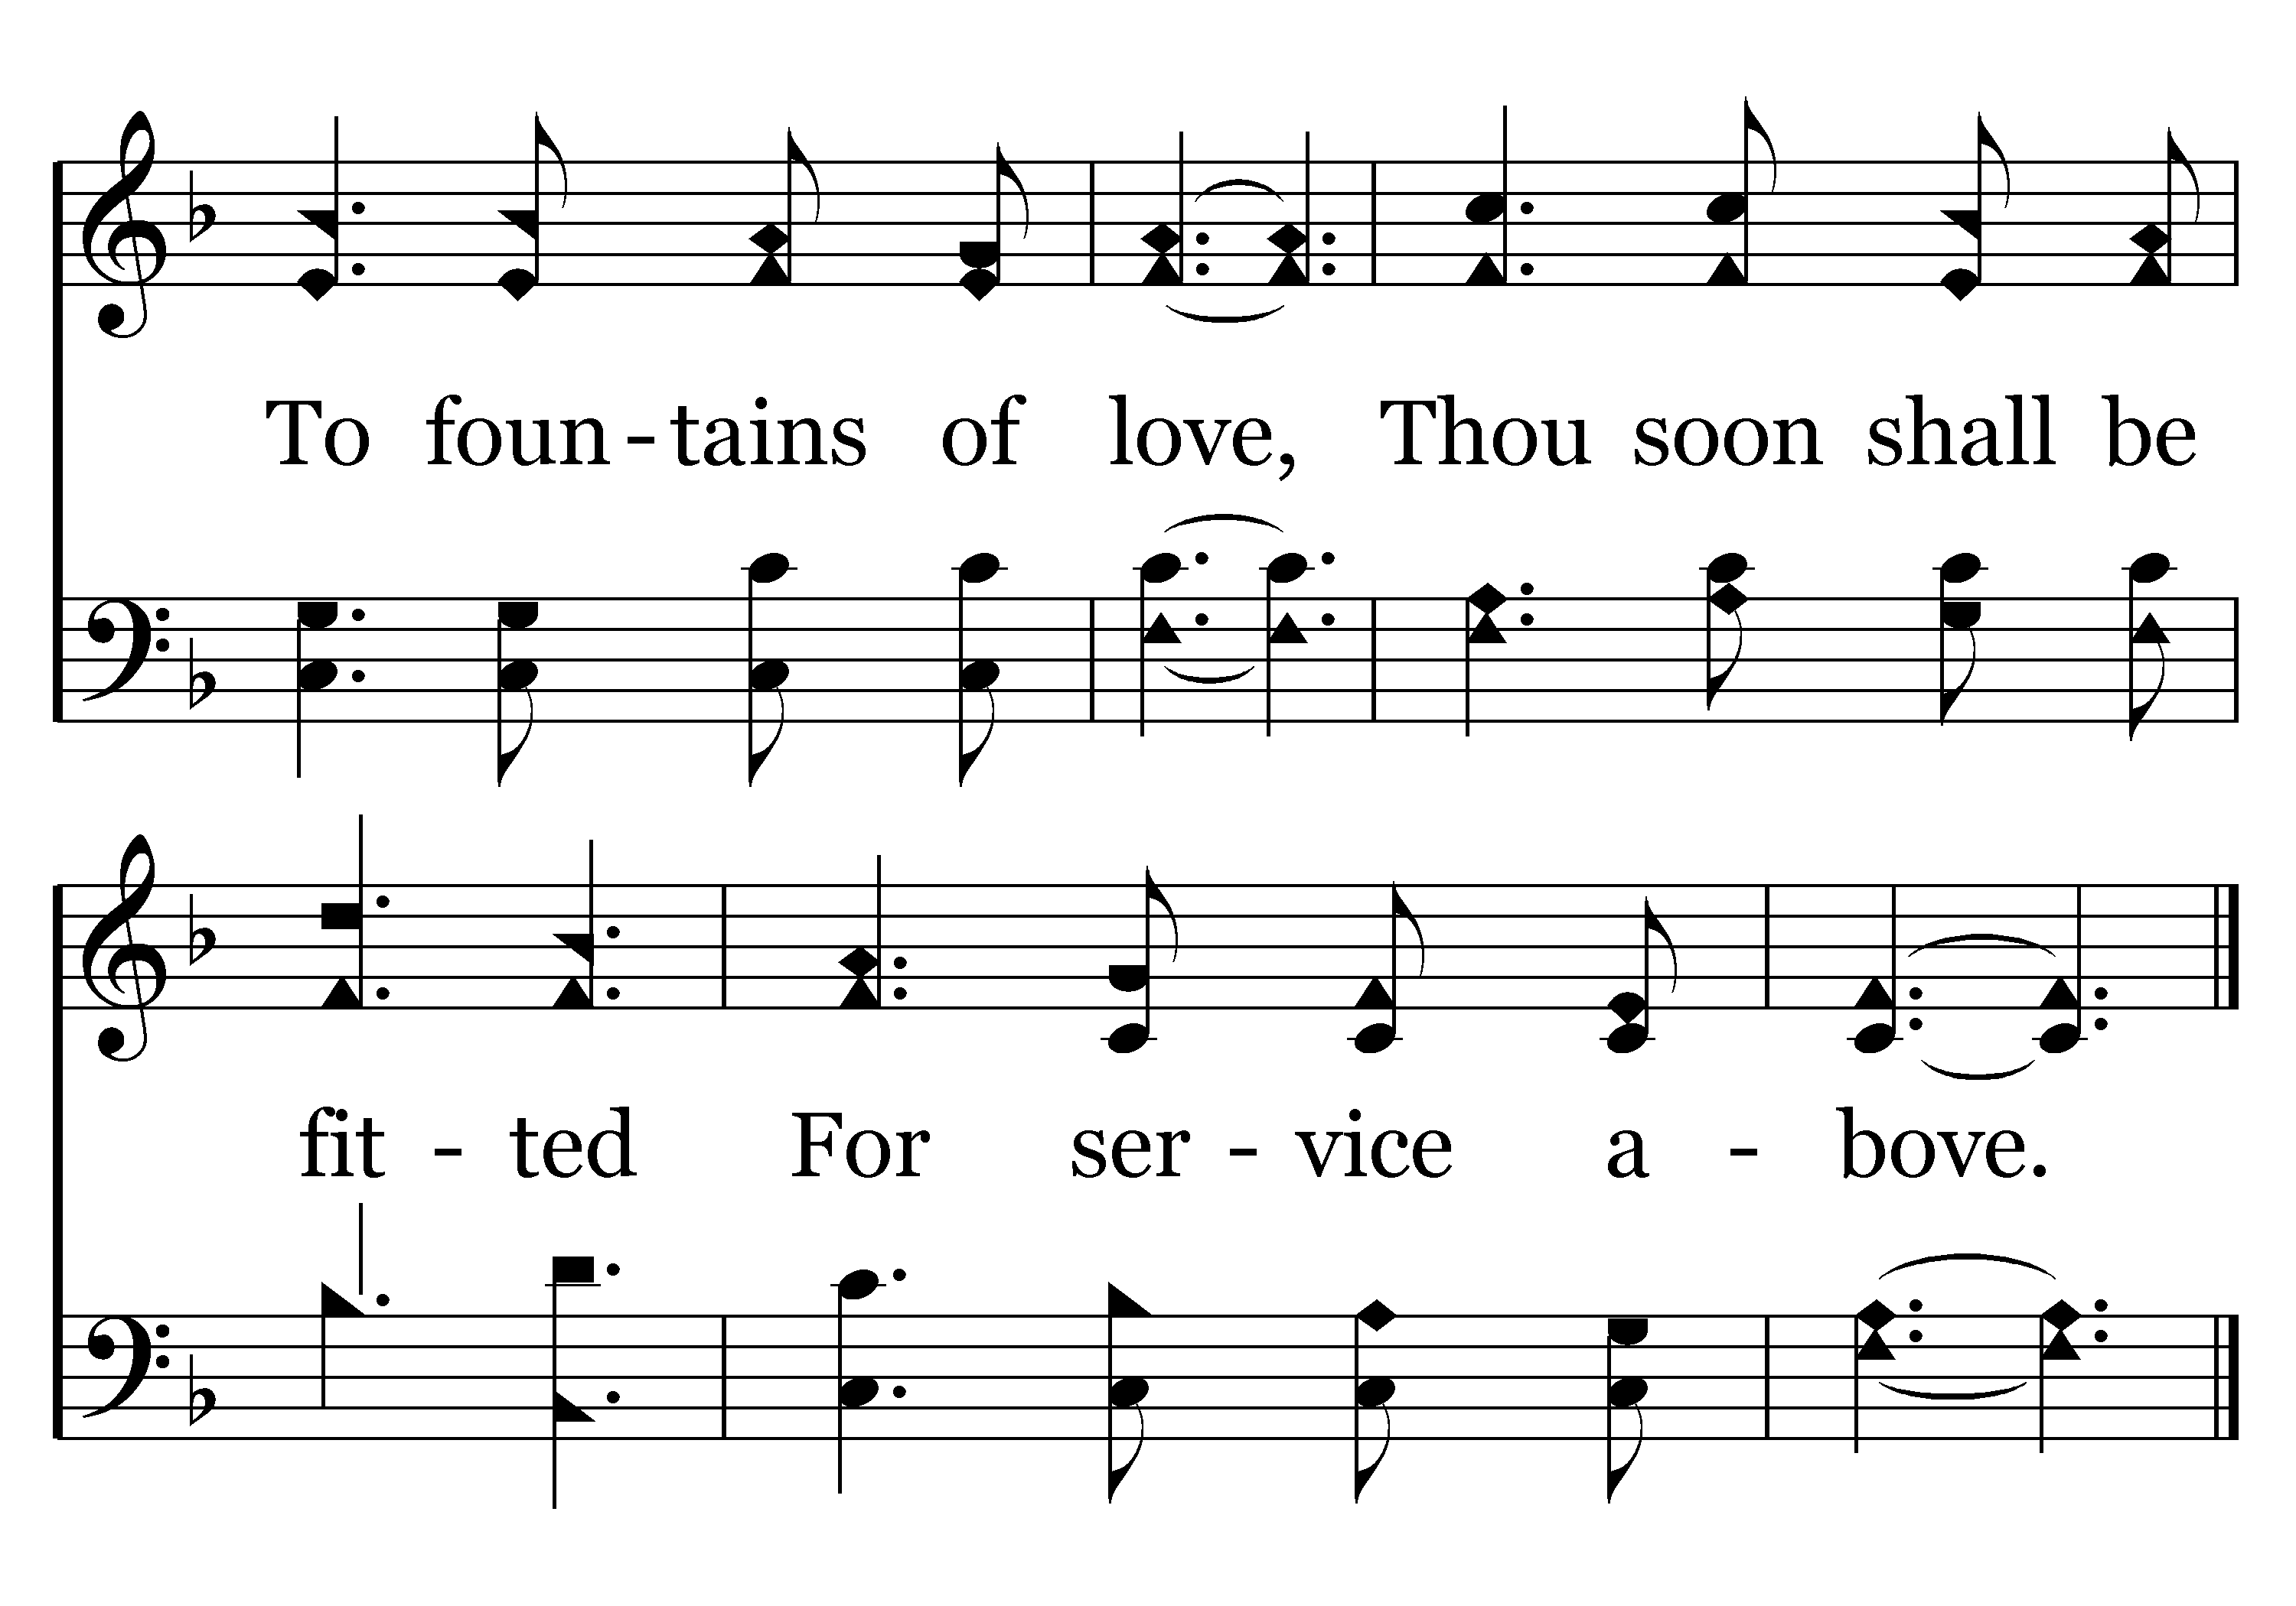
118 - Take Time To Be Holy - 3.3
End of Song

Slide 13

Calm Down To Be Holy
Anxiety is one of our greatest enemies
Listen to Jesus in Matthew 6:25-33
Take your anxieties to God- Phil. 4:4-9

Slide 14

God’s Plan of Salvation
Hear- Romans 10:17
Believe- Mark 16:16
Repent- Acts 2:38
Confess- Romans 10:9-10
Be baptized- Acts 22:16
Remain faithful- Revelation 2:10

