Slide 2
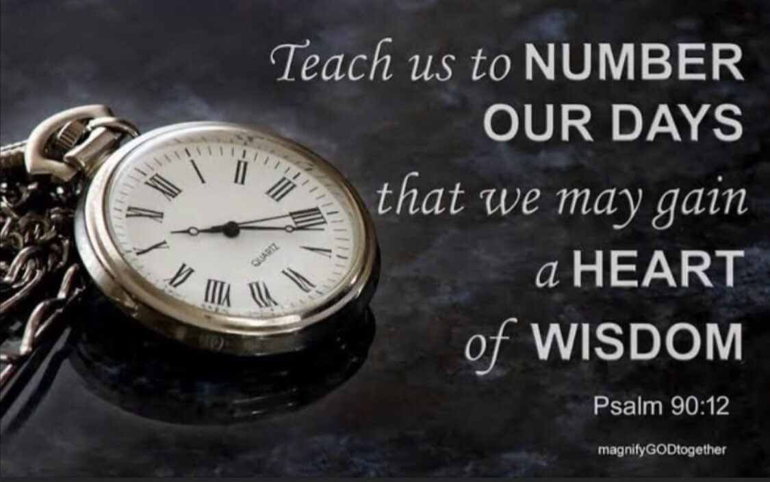

Slide 3

“Teach us”
We should desire teaching from God’s word- Acts 17:11
Many are like those of Jeremiah 6:16
Why study?- II Timothy 2:15; 3:16-17; Revelation 1:3

Slide 4

“To number our days”
The psalmist tells us to do something we cannot do.
He means
  Death will come- Hebrews 9:27
  Life passes rapidly- Psalm 90:10; 103:15-16; James 4:13-17
  You can lose your life at any moment- I Samuel 20:3; Luke 12:13-20

Slide 5

“That we may apply our hearts to wisdom”
“Walk in the good ways”- Jeremiah 6:16
Ephesians 5:15-16- living wisely has to do with using our time wisely
To apply our hearts to wisdom is to realize that some things are simply more important than other things
JOY (Jesus, Others, Yourself)

