Slide 2
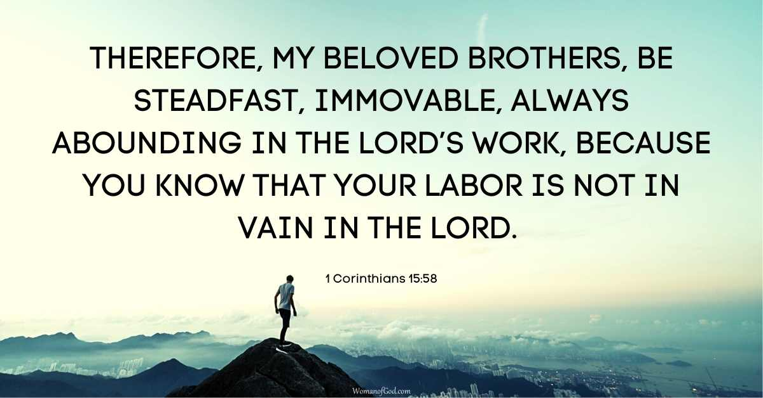

Slide 3

Stand, Stay, Grow

Slide 4


Slide 5


Slide 6

Always Abounding

