Slide 2
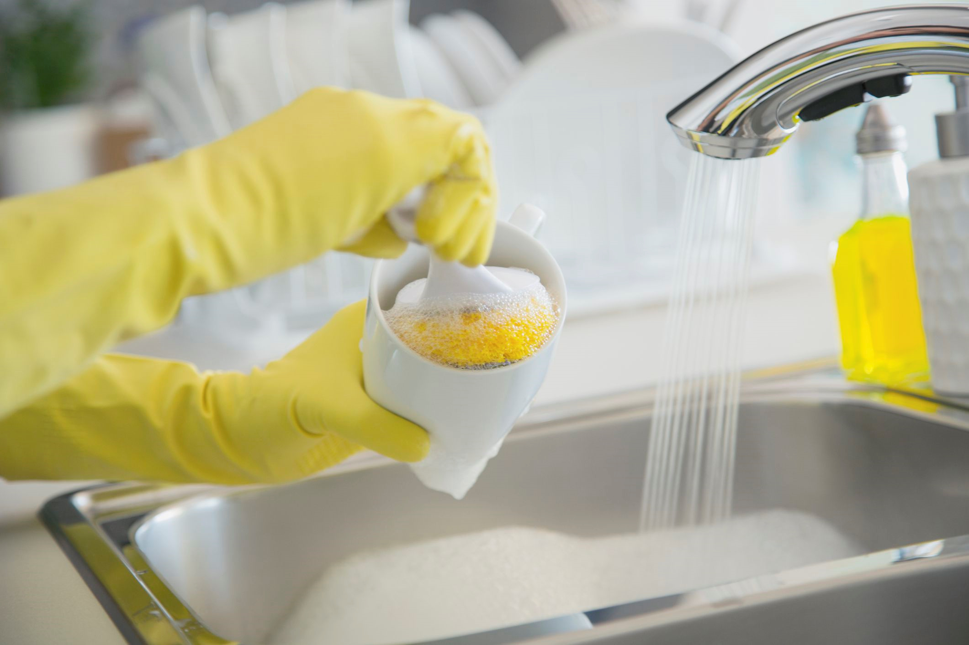
How Can we not be an unwashed pot
Matthew 23:26

Slide 3


Slide 4
How to clean the Inside of the cup
Ask God to cleanse your heart- Proverbs 20:9, Psalm 51:10, Psalm 139:23-24
Pray without ceasing- Philippians 4:6-7, 1 thess. 5:17
Become single-minded- James 4:8, Matthew 6:24-25
Set your mind on God’s things- Matt. 16:23, Isaiah 55:8-9, Colossians 3:2, Philippians 4:8
Be in God’s word- Psalm 119

Slide 5
