Slide 2
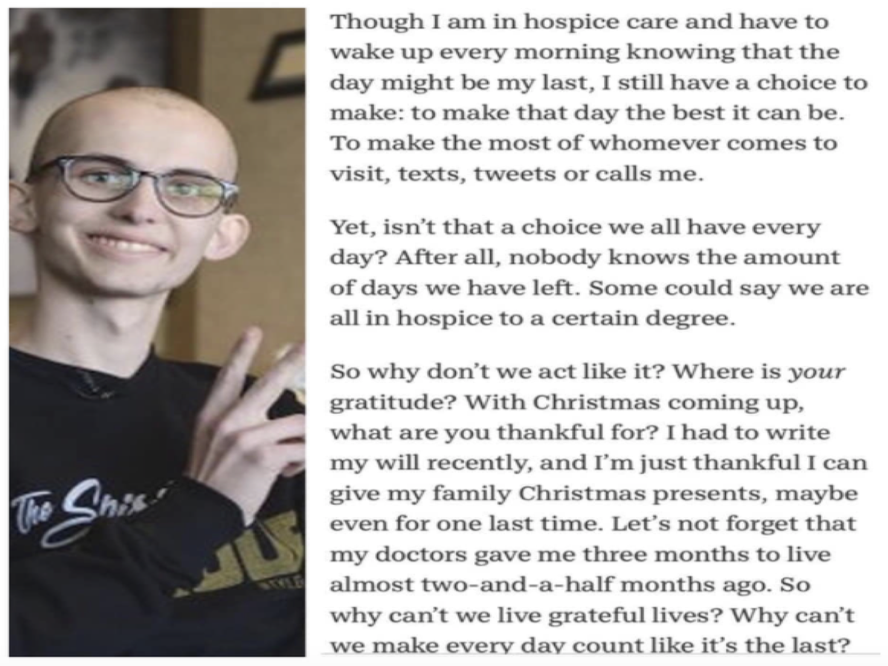

Slide 3

James 4:13-17

Slide 4

Today, I will remember who is really in control
Vs. 13- “Today or tomorrow WE will…”
They needed to say, “If the Lord wills…”
Proverbs 16:9- God is the one who is in control
Jesus taught this in Luke 12:16-21
Two steps to living this way
  I recognize that I am not in control
  I recognize that God is, and that is good. (Matt. 6:25-34)

Slide 5

Today, I will acknowledge the Lord
These business men only knew to acknowledge themselves
James 4:15- “If the Lord wills, we will live and do this or that”
We must know God is in control and acknowledge God is in control- Proverbs 3:6

Slide 6

Today I will live in the present
James 4:14- “Yet you do not know what tomorrow will bring.”
Some live in the future, fantasizing about how wonderful everything will be- Proverbs 27:1
Some live in the future, worrying about how awful things will be- Matthew 6:25-34

Slide 7

Today I will do what the Lord wills
James 4:15- “If the Lord wills”
Instead of boasting in all of my plans, wants, and desires. I need to discover the Lord’s plans, wants, and desires.
We need to surrender our lives to the Lord- Luke 6:46; Matt. 6:33

Slide 8

Today I will do what is right without procrastinating
James 4:17- “whoever knows the right thing to do and fails to do it, for him it is sin.”
We don’t know what tomorrow may bring, so do the right thing now.
Don’t procrastinate- Proverbs 3:27-28

