Slide 1
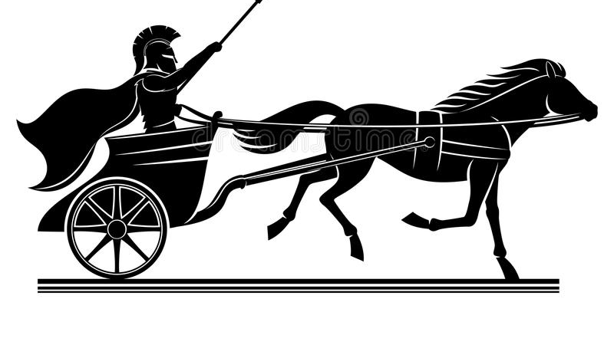
Roll the Gospel Chariot Song
Roll the gospel chariot along,
Roll the gospel chariot along,
Roll the gospel chariot along,
And we won't tag along behind.
If a sinner's in the way, we will stop and pick him up, (x3)
And we won't tag along behind.
If the devil's in the way, we will roll right over him, (x3)
And we won't tag along behind.
Repeat vs. 1

Slide 2
The Gospel Must Be Proclaimed
”Roll The Gospel Chariot Along”
It is our job to spread the gospel- Matt 28:19-20; Mark 16:15-16
The Gospel is NOT-
Mans wisdom
Our opinions
What the majority believes
What IS the Gospel?
It is God’s truth- John 17:17
It is the message of Jesus Christ
The Gospel is what we must to do be saved- Rom. 1:16

Slide 3
Who Do We Proclaim The Gospel To?
”If a sinners in the way…”
Who are the sinners?
Those who have never obeyed the gospel- 1 Cor. 6:9-11
Fallen Christians- Gal. 6:1-2, 1 Thess. 5:14-15, Matt. 18:15-17
How to find the sinners?
“roll the gospel chariot” implies actively going out
Keeping our eyes open- John 4:30-35
Go where the lost are- Matt. 4:19

Slide 4
Satan Will Try To Stop The Gospel
”If the devils in the way”
Satan has & will always try to stop our efforts
We are in a spiritual battle with Satan- 1 Peter 5:8
How does Satan stop the spread of the Gospel?
He makes some believe God’s word is not true- Gen. 3:1-5
He makes some believe they have more time
He will use family- Luke 14:25-33
He will use false teachers- II Tim. 4:1-5
He will use personal trials
He will use physical possessions- Matt. 19:16-22, Luke 16:13

