Slide 2
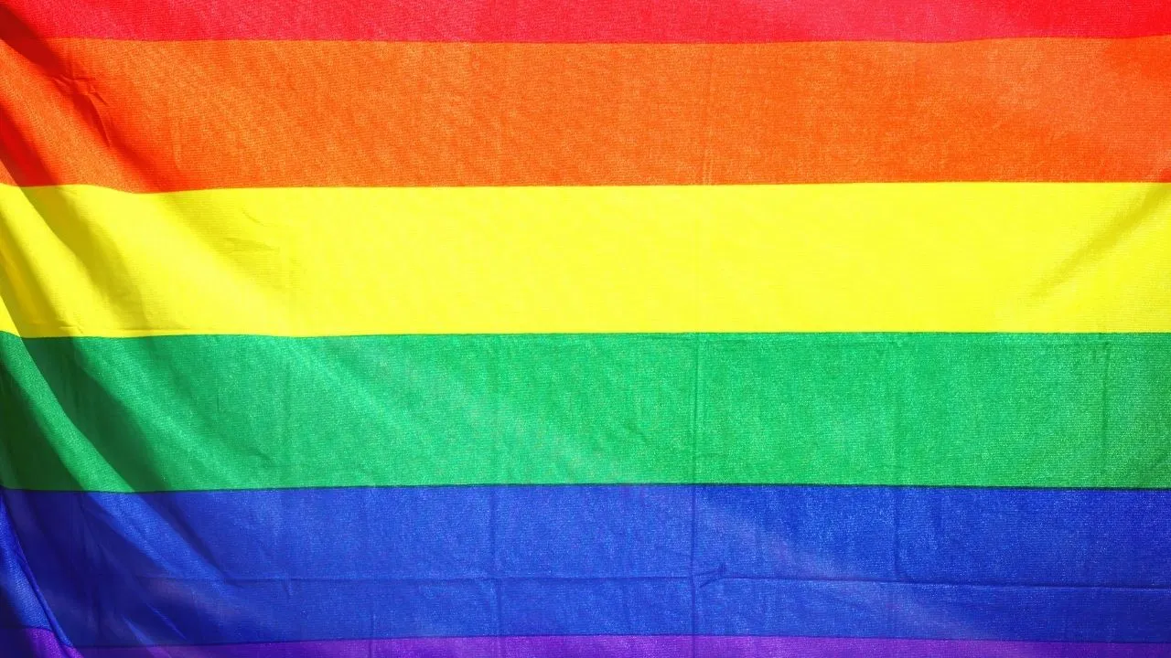
Prideful Sin
A Look at Homosexuality

Slide 3

Is God True To His Word?
Adam and Eve- Genesis 2:16-17; 3:1-3
The people of Noah’s day- Genesis 6:7;
Lot’s family- Genesis 19:17; 26

Slide 4
Applied to Homosexuality
What God says about marriage- Genesis 2:18-24; Matthew 19:1-9; I Cor. 7:1-4
I Cor. 6:9-10; Galatians 5:19-21; Romans 1:26-27
Does God mean what He says? -Isaiah 59:1-2; Romans 6:23

Slide 5
Supporting Homosexuality
Can we support those who practice homosexuality? -Romans 1:26-32
Why are religious organizations supporting homosexuality?

Slide 6
Supporting Homosexuality
The church has been working toward a greater understanding and radical inclusion of all of God’s children for nearly a half-century. In 1974, IntegrityUSA was founded, a non-profit organization with the goal of full-inclusion of LGBT persons in The Church. The next General Convention, in 1976, adopted resolutions stating that “homosexual persons are children of God who have a full and equal claim with all other persons upon the love, acceptance, and pastoral concern and care of the Church” and that they “are entitled to equal protection of the laws with all other citizens” … Over the years, General Convention and Executive Council reaffirmed these resolutions, as well as calling the church to greater understanding, awareness, and inclusion of LGBTQ persons in the life of the church….

Slide 7
Supporting Homosexuality
(cont.) The Church warmly welcomes our LGBTQ siblings, but it would be disingenuous to say that the entire church is in the same place on this journey. As with all spiritual journeys, everyone walks at their own pace. Some congregations are actively involved in LGBTQ ministry and their arms are open wide; others are more reserved, but their doors are still open to all; some are still wrestling with their beliefs and feelings. But we’re on this journey together, and The Church is dedicated to full inclusion and equality in the church as well as in society as a whole.

Slide 8
Supporting Homosexuality
The Church voted to allow pastors to perform same-sex “marriages” and to change its official definition of marriage to the union of “two people” by a margin of more than three-to-one at its General Assembly. Seventy-six percent of voting delegates favored the measure to change the definition of marriage contained in the church's constitution, the Book of Order, from a union of “a man and a woman” to “two people.” The vote count was 429-175.

Slide 9
Supporting Homosexuality
Since 1969 various national settings of the (this denomination) have addressed the concerns of lesbian, gay, bisexual and transgender (LGBT) people in church and society, calling for welcome, inclusion and justice.

Slide 10
Supporting Homosexuality
Can we support those who practice homosexuality? -Romans 1:26-32
Why are religious organizations supporting homosexuality?
How can we support a religion that questions God’s Word?

Slide 11
Arguments to address
Some argue that God is a God of love and to hate goes against God’s nature
Some argue we are not to hate those who practice sin because god doesn’t hate, he loves
Some argue we pick and choose which sins to hate

