Slide 2
How could a Christian do that?
Notes:
Whenever something like this happens, it is an almost guaranteed thing for someone to ask, “How could a Christian do that?”

Slide 3
How could a Christian do that?
How do we respond to the penitent sinner?
Notes:
Whenever something like this happens, it is an almost guaranteed thing for someone to ask, “How could a Christian do that?”

Slide 4
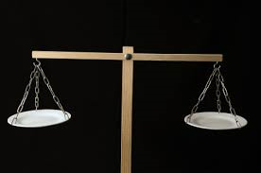
HOW SHOULD WE RESPOND?
Why does it matter how we respond?
I Corinthians 5:1-2,6
II Corinthians 2:5-11
A little leaven, leavens the whole lump!
Overwhelmed by excessive sorrow

Slide 5
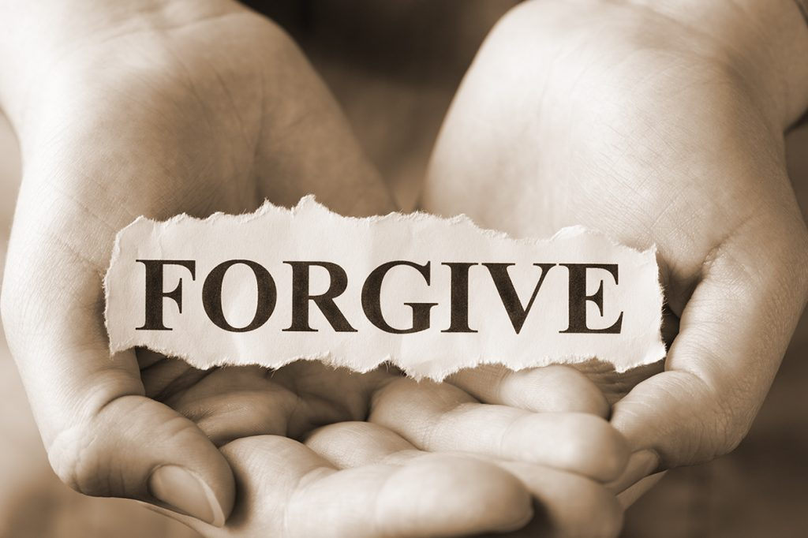
Step 1: Forgive
We are to forgive as God Forgives- I John 1:9
What if God didn’t forgive- Isaiah 59:1-2; Romans 6:23
God wants to forgive- II Peter 3:9
Therefore, we also forgive- Matt. 18:21-35
If we forgive, we do not use it against them later

Slide 6
Step 2: Comfort
I Thessalonians 5:11,14
“Comfort”- literally means “to call alongside”
Some things that are not comforting
Acting so shocked someone would commit that sin
Questioning their love for God
Telling them we’ve never had a problem with that sin
Comparing them to others
Asking them, How could you do that?
Just telling them to Stop

Slide 7
Step 2: Comfort
Some things that are comforting
Telling them that they are doing the right thing by confessing- James 5:16
Letting them know that you’ve been there- Romans 7:13-24
Remind them of God’s love- Romans 5:6-8
Remind them of the hope of victory we have in Christ
Share your own experience, strength, and hope from your struggles
Remind them of their progress and victories.
Sometimes just listening and giving them a hug

Slide 8
Step 3: Reaffirm your love
This is unconditional love (agape)
Paul defined this love in I Cor. 13:4-7
Reaffirm is used in only one other place- Galatians 3:15
There it is the word “ratified”

Slide 9
Step 4: Repeat
This comes more from Luke 17:3-4
WE want to say repetition demonstrates a lack of real repentance
Jesus tells us to let God deal with that
Our job is to forgive, comfort, and reaffirm our love
Since we are all growing, this process will happen over and over again

Slide 10
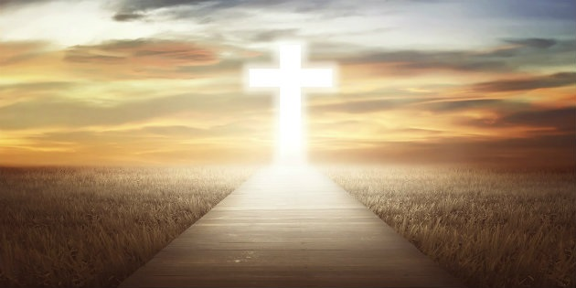
God’s plan of salvation
Hear- Romans 10:17
Believe- Mark 16:16
Repent- Acts 2:38
Confess- Romans 10:9-10
Be baptized- Acts 22:16
Remain faithful- Revelation 2:10

