Slide 1
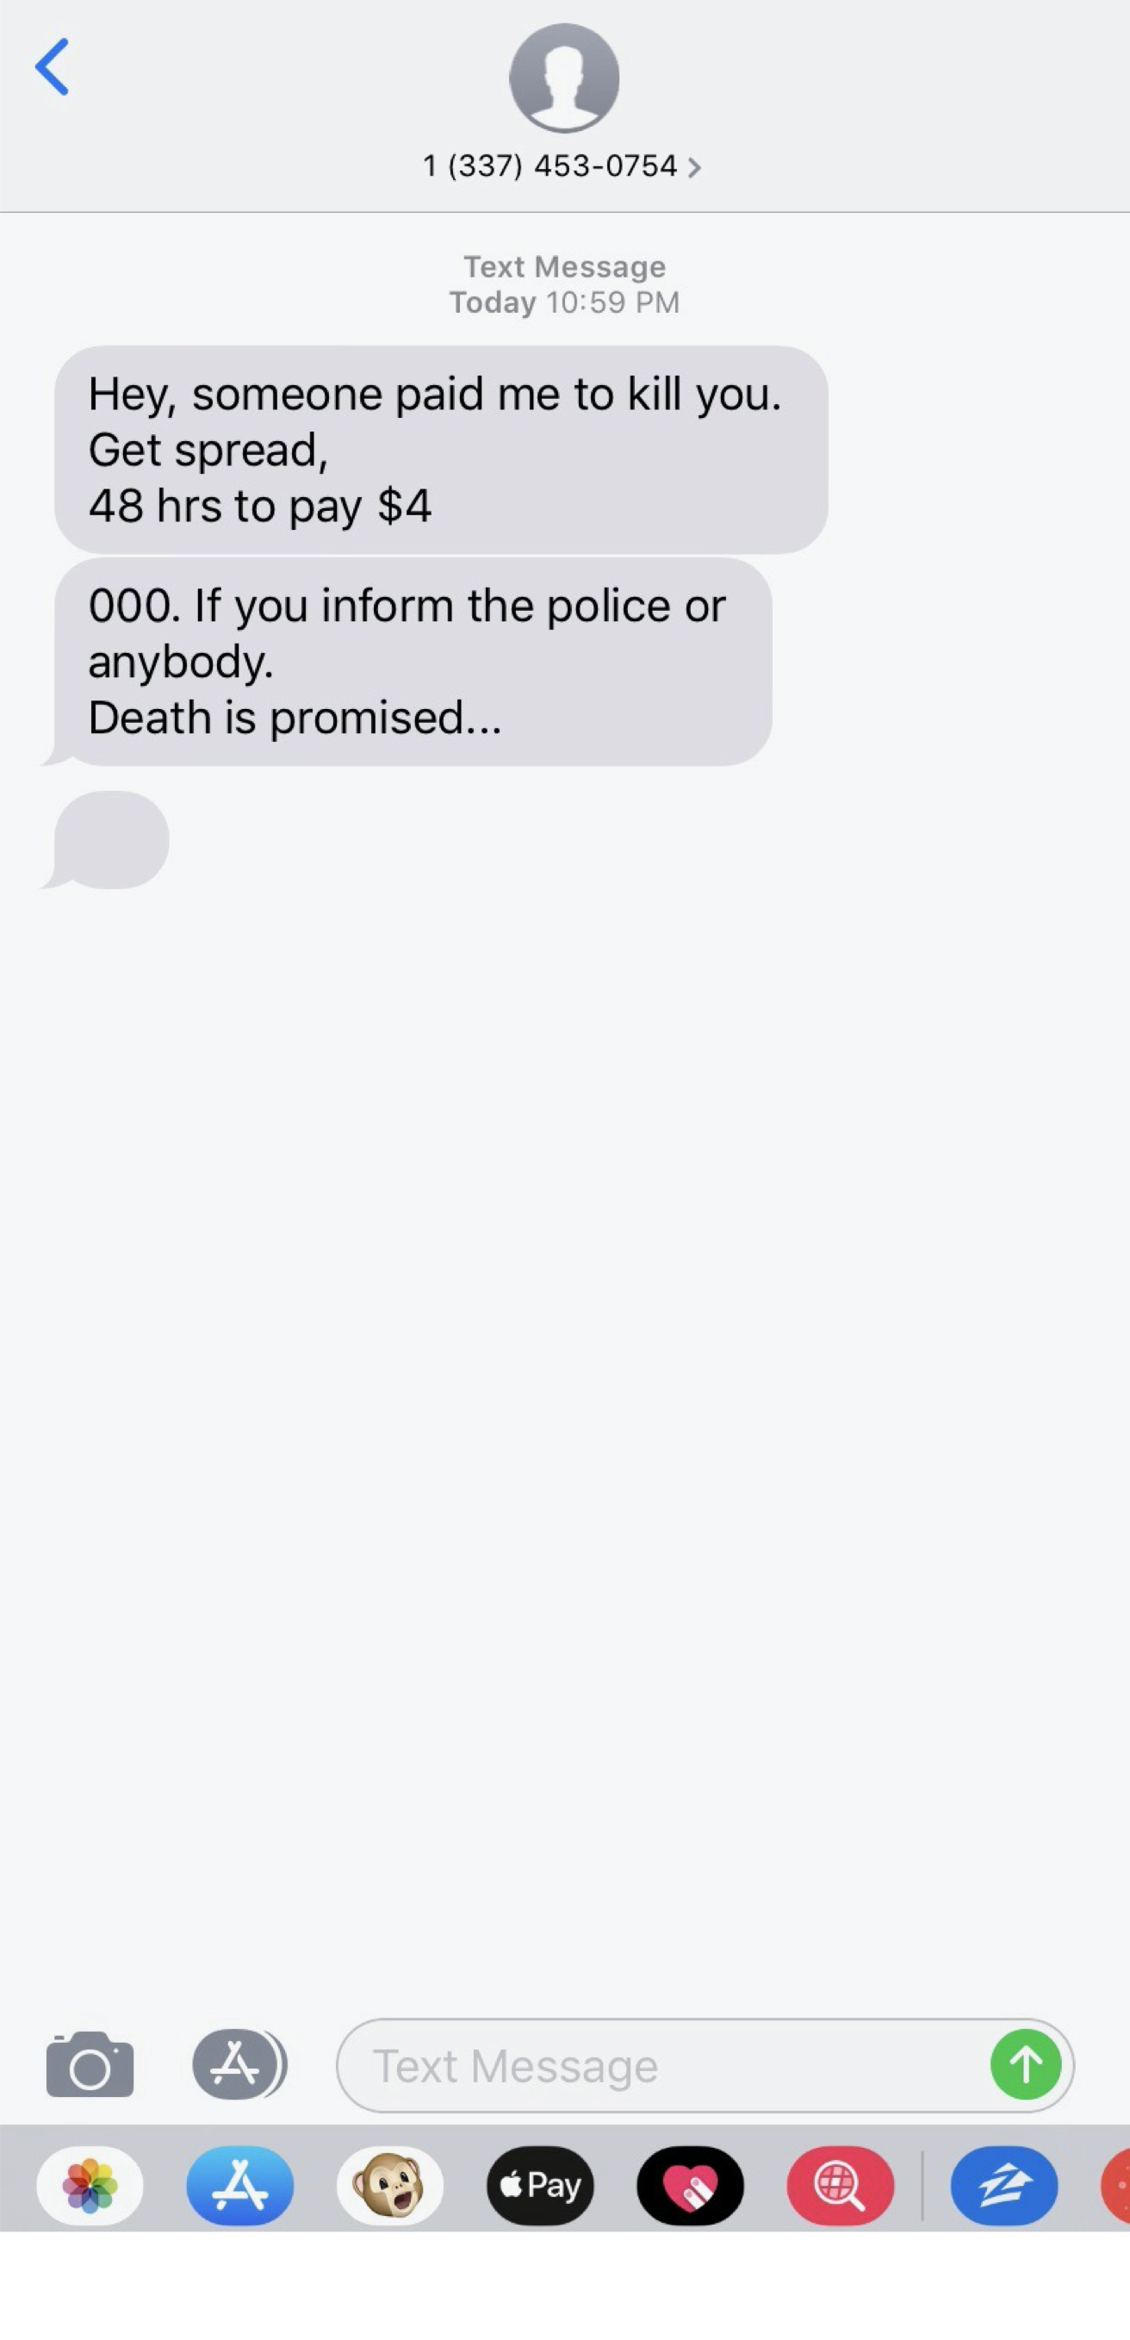

Slide 2
Satan Stalks

Slide 3
Satan’s Attack
Satan Lies- John 8:44
Satan Uses our natural desires- I John 2:16
Satan uses others- Matthew 16:22-23
Satan uses our emotions- Ephesians 4:26

Slide 4
Acts 2:42- “And they continued steadfastly in the apostles’ doctrine and fellowship, in the breaking of bread, and in prayers.”
Take Refuge in God

Slide 5
Acts 2:42- “And they continued steadfastly in the apostles’ doctrine and fellowship, in the breaking of bread, and in prayers.”
Take Refuge in God

Slide 6
Acts 2:42- “And they continued steadfastly in the apostles’ doctrine and fellowship, in the breaking of bread, and in prayers.”
Take Refuge in God

Slide 7
Acts 2:42- “And they continued steadfastly in the apostles’ doctrine and fellowship, in the breaking of bread, and in prayers.”
Take Refuge in God

Slide 8
Acts 2:42- “And they continued steadfastly in the apostles’ doctrine and fellowship, in the breaking of bread, and in prayers.”
Take Refuge in God

