Slide 2
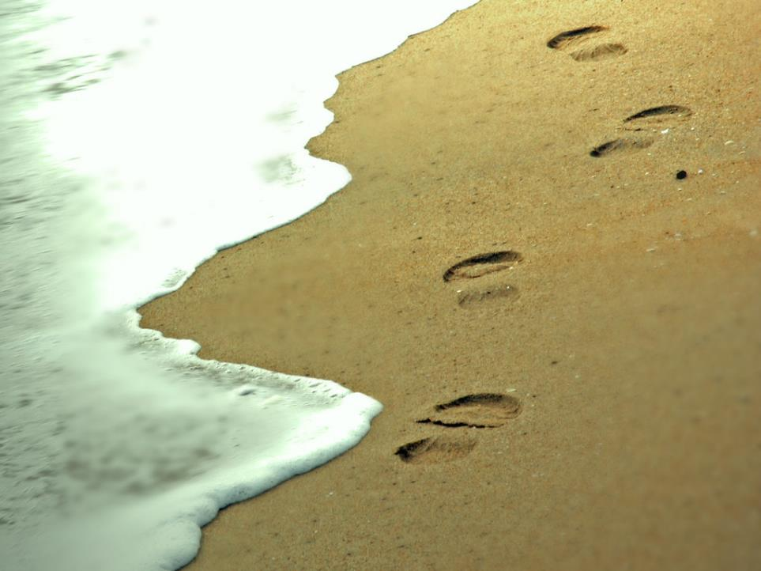
Following Jesus
The Gospel of Mark

Slide 3
The beginning of the gospel of Jesus Christ, the Son of God.
Mark 1:1

Slide 4
Jesus is good news.
The beginning of the gospel of Jesus Christ, the Son of God.
Mark 1:1

Slide 5
Jesus is good news.
Now after John was arrested, Jesus came into Galilee, proclaiming the gospel of God, and saying, “The time is fulfilled, and the kingdom of God is at hand; repent and believe in the gospel.”
Mark 1:14-15
The beginning of the gospel of Jesus Christ, the Son of God.
Mark 1:1

Slide 6
Jesus is good news.
For whoever would save his life will lose it, but whoever loses his life for my sake and the gospel's will save it.
Mark 8:35
The beginning of the gospel of Jesus Christ, the Son of God.
Mark 1:1

Slide 7
Jesus is good news.
Jesus said, “Truly, I say to you, there is no one who has left house or brothers or sisters or mother or father or children or lands, for my sake and for the gospel, who will not receive a hundredfold now in this time, houses and brothers and sisters and mothers and children and lands, with persecutions, and in the age to come eternal life.”
Mark 10:29-30
The beginning of the gospel of Jesus Christ, the Son of God.
Mark 1:1

Slide 8
Jesus is good news.
And the gospel must first be proclaimed to all nations.
Mark 13:10
The beginning of the gospel of Jesus Christ, the Son of God.
Mark 1:1

Slide 9
Jesus is good news.
And truly, I say to you, wherever the gospel is proclaimed in the whole world, what she has done will be told in memory of her.
Mark 14:9
The beginning of the gospel of Jesus Christ, the Son of God.
Mark 1:1

Slide 10
Jesus is good news.
And He said to them, “Go into all the world and preach the gospel to every creature. He who believes and is baptized will be saved; but he who does not believe will be condemned.”
Mark 16:15-16
The beginning of the gospel of Jesus Christ, the Son of God.
Mark 1:1

Slide 11
Jesus is good news.
The beginning of the gospel of Jesus Christ, the Son of God.
Mark 1:1

Slide 12
Jesus is good news.
in mighty signs and wonders, by the power of the Spirit of God, so that from Jerusalem and round about to Illyricum I have fully preached the gospel of Christ.
Romans 15:19
The beginning of the gospel of Jesus Christ, the Son of God.
Mark 1:1

Slide 13
Jesus is good news.
If others are partakers of this right over you, are we not even more? Nevertheless we have not used this right, but endure all things lest we hinder the gospel of Christ.
1 Corinthians 9:12
The beginning of the gospel of Jesus Christ, the Son of God.
Mark 1:1

Slide 14
Jesus is good news.
When I came to Troas to preach the gospel of Christ, even though a door was opened for me in the Lord
2 Corinthians 2:12
The beginning of the gospel of Jesus Christ, the Son of God.
Mark 1:1

Slide 15
Jesus is good news.
By their approval of this service, they will glorify God because of your submission that comes from your confession of the gospel of Christ, and the generosity of your contribution for them and for all others
2 Corinthians 9:13
The beginning of the gospel of Jesus Christ, the Son of God.
Mark 1:1

Slide 16
Jesus is good news.
For we are not overextending ourselves, as though we did not reach you. For we were the first to come all the way to you with the gospel of Christ.
2 Corinthians 10:14
The beginning of the gospel of Jesus Christ, the Son of God.
Mark 1:1

Slide 17
Jesus is good news.
Only let your manner of life be worthy of the gospel of Christ, so that whether I come and see you or am absent, I may hear of you that you are standing firm in one spirit, with one mind striving side by side for the faith of the gospel
Philippians 1:27
The beginning of the gospel of Jesus Christ, the Son of God.
Mark 1:1

Slide 18
Jesus is good news.
The beginning of the gospel of Jesus Christ, the Son of God.
Mark 1:1

Slide 19
Jesus is good news.
The beginning of the gospel of Jesus Christ, the Son of God.
Mark 1:1

Slide 20
Jesus is good news.
Jesus is the Son of God.
The beginning of the gospel of Jesus Christ, the Son of God.
Mark 1:1

Slide 21
Jesus is good news.
Jesus is the Son of God.
Then a voice came from heaven, “You are My beloved Son, in whom I am well pleased.”
Mark 1:11
The beginning of the gospel of Jesus Christ, the Son of God.
Mark 1:1

Slide 22
Jesus is good news.
Jesus is the Son of God.
And the unclean spirits, whenever they saw Him, fell down before Him and cried out, saying,
“You are the Son of God.”
Mark 3:11
The beginning of the gospel of Jesus Christ, the Son of God.
Mark 1:1

Slide 23
Jesus is good news.
Jesus is the Son of God.
So when the centurion, who stood opposite Him, saw that He cried out like this and breathed His last, he said, “Truly this Man was the Son of God!”
Mark 15:39
The beginning of the gospel of Jesus Christ, the Son of God.
Mark 1:1

Slide 24
Jesus is good news.
Jesus is the Son of God.
The beginning of the gospel of Jesus Christ, the Son of God.
Mark 1:1

Slide 25
Jesus is good news.
Jesus is the Son of God.
The beginning of the gospel of Jesus Christ, the Son of God.
Mark 1:1

