Slide 2
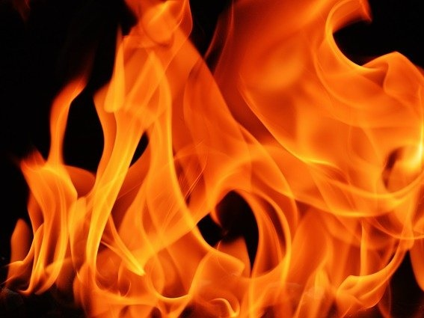
The Burning Bush

Slide 4
Now Mount Sinai was all in smoke because the Lord descended upon it in fire; and its smoke ascended like the smoke of a furnace, and the entire mountain quaked violently.
Exodus 19:18

Slide 5
And to the eyes of the sons of Israel, the appearance of the glory of the Lord was like a consuming fire on the mountain top.
Exodus 24:17

Slide 6
And fire came out from the presence of the Lord and consumed them, and they died before the Lord.
Leviticus 10:2

Slide 7
You came forward and stood at the foot of the mountain, and the mountain was burning with fire to the heart of the heavens: darkness, cloud, and thick gloom. Then the Lord spoke to you from the midst of the fire; you heard the sound of words, but you saw no form—there was only a voice.
Deuteronomy 4:11-12

Slide 9
When the Lord saw that he turned aside to look, God called to him from the midst of the bush and said, “Moses, Moses!”
And he said, “Here I am.”
Exodus 3:4

Slide 10
Are not two sparrows sold for a copper coin? And not one of them falls to the ground apart from your Father’s will. But the very hairs of your head are all numbered. Do not fear therefore; you are of more value than many sparrows.
Matthew 10:29-31

Slide 12
Then He said, “Do not come near here; remove your sandals from your feet, for the place on which you are standing is holy ground.”
Exodus 3:5

Slide 13
but as He who called you is holy, you also be holy in all your conduct, because it is written,
“Be holy, for I am holy.”
1 Peter 1:15-16

Slide 14
And He said, “I am the God of your father—the God of Abraham, the God of Isaac,
and the God of Jacob.”
Then Moses hid his face, for he was afraid to look at God.
Exodus 3:6

Slide 15
“But concerning the resurrection of the dead, have you not read what was spoken to you by God, saying, ‘I am the God of Abraham, the God of Isaac, and the God of Jacob’? God is not the God of the dead, but of the living.”
Matthew 22:31-32

Slide 16
And the Lord said: “I have surely seen the oppression of My people who are in Egypt, and have heard their cry because of their taskmasters, for I know their sorrows. So I have come down to deliver them out of the hand of the Egyptians, and to bring them up from that land to a good and large land, to a land flowing with milk and honey, to the place of the Canaanites and the Hittites and the Amorites and the Perizzites and the Hivites and the Jebusites. Now therefore, behold, the cry of the children of Israel has come to Me, and I have also seen the oppression with which the Egyptians oppress them. Come now, therefore, and I will send you to Pharaoh that you may bring My people, the children of Israel, out of Egypt.”
Exodus 3:7-10

