Slide 2
Elisha and the Shunammite without a Son
2 Kings 4:8-17

Slide 3
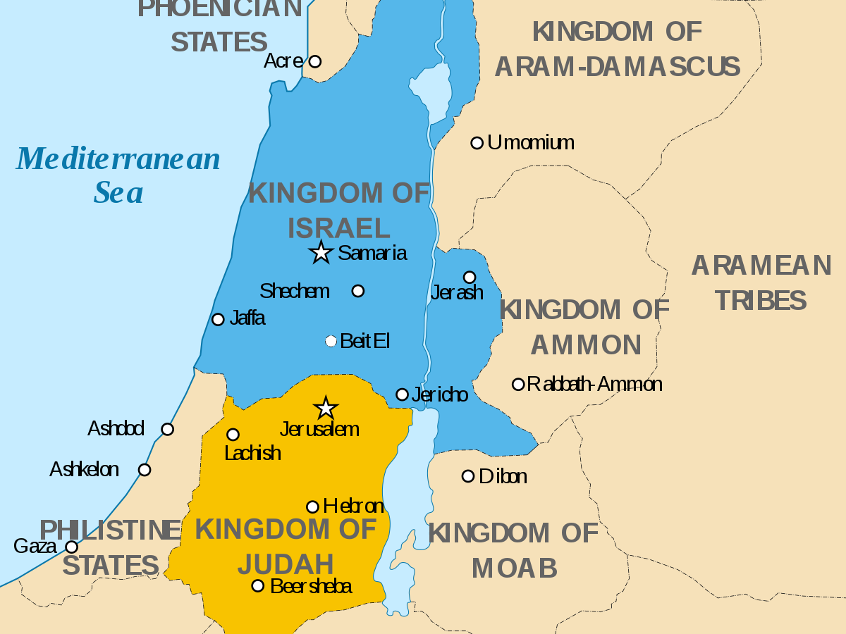

Slide 4
Elisha and the Shunammite without a Son
2 Kings 4:8-17

Slide 5
He said, “I will surely return to you at this time next
year; and behold, Sarah your wife will have a son.” And Sarah was listening at the tent door, which was behind him. Now Abraham and Sarah were old, advanced in
age; Sarah was past childbearing. Sarah laughed
to herself, saying, “After I have become old, shall I
have pleasure, my lord being old also?”
Genesis 18:10-12

Slide 6
There was a certain man of Zorah, of the family of the Danites, whose name was Manoah; and his wife was barren and had borne no children. Then the angel of the Lord appeared to the woman and said to her, “Behold now, you are barren and have borne no children, but you shall conceive and give birth to a son.
Judges 13:2-3

Slide 7
He had two wives: the name of one was Hannah and the name of the other Peninnah; and Peninnah had children, but Hannah had no children.
…It came about in due time, after Hannah had conceived, that she gave birth to a son; and she named him Samuel, saying, “Because I have asked him of the Lord.”
1 Samuel 1:2, 20

Slide 8
In the days of Herod, king of Judea, there was a priest named Zacharias, of the division of Abijah; and he had a wife from the daughters of Aaron, and her name was Elizabeth. They were both righteous in the sight of God, walking blamelessly in all the commandments and requirements of the Lord. But they had no child, because Elizabeth was barren, and they were both advanced in years.
Luke 1:5-7

Slide 9
But the angel said to him, “Do not be afraid, Zacharias, for your petition has been heard, and your wife Elizabeth will bear you a son, and you will give him the name John. You will have joy and gladness, and many will rejoice at his birth.
…Zacharias said to the angel, “How will I know this for certain? For I am an old man and my wife is advanced in years.”
…After these days Elizabeth his wife became pregnant Luke 1:13-14, 18, 24

Slide 11
The Lord will make you abound in prosperity, in the offspring of your body and in the offspring of your beast and in the produce of your ground, in the land which the Lord swore to your fathers to give you. Deuteronomy 28:11
See also Ex 23:26; Lev 26:9; Deut 7:14; Ps 113:9

Slide 12
Mary will give birth to the eternal King.
Luke 1:26-45

Slide 13
Jesus answered and said to him, “Truly, truly, I say to
you, unless one is born again he cannot see the
kingdom of God.”
Nicodemus said to Him, “How can a man be born when he is old? He cannot enter a second time into his mother’s womb and be born, can he?” Jesus answered, “Truly, truly, I say to you, unless one is born of water and the Spirit he cannot enter into the kingdom of God.
John 3:3-5

