Slide 2
9 statements of blessedness
6 areas of greater righteousness
3 areas of quiet righteousness

Slide 3
Do not store up for yourselves treasures on earth… 6:19
…do not be worried…
6:25
Disciples and Possessions
Do not judge…
7:1
Do not give what is holy to the dogs…
7:6

Slide 4
Do not store up for yourselves treasures on earth… 6:19
Two Treasures (6:19-21)
Two Eyes (6:22-23)
Two Masters (6:24)

Slide 5
“do not worry about your life” Matthew 6:25
“Therefore do not worry” Matthew 6:31
“Therefore do not worry about tomorrow” Matthew 6:34

Slide 6
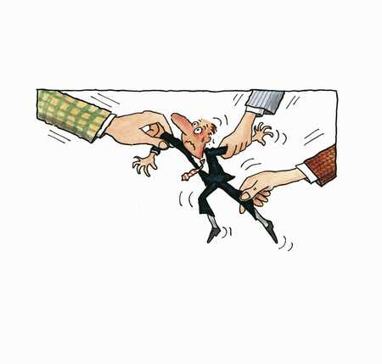
“do not worry about your life” Matthew 6:25
“Therefore do not worry” Matthew 6:31
“Therefore do not worry about tomorrow” Matthew 6:31
“goes to pieces”

Slide 7
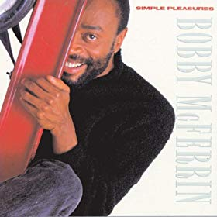

Slide 8
²⁵ “Therefore I say to you, do not worry about your life,
what you will eat or what you will drink; nor about your body, what you will put on.

Slide 9
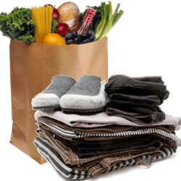
1) Is not life more than food and the body more than clothing?

Slide 10
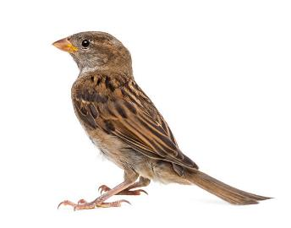
2) ²⁶ Look at the birds of the air, for they neither sow nor reap nor gather into barns; yet your heavenly Father feeds them.
Are you not of more value than they?

Slide 11
3) ²⁷ Which of you by worrying can add one cubit to his stature?

Slide 12
4) ²⁸ “So why do you worry about clothing? Consider the lilies of the field, how they grow: they neither toil nor spin; ²⁹ and yet I say to you that even Solomon in all his glory was not arrayed like one of these.

Slide 13
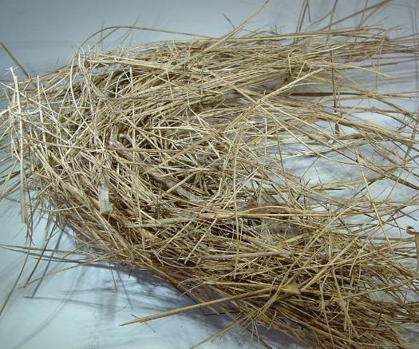
³⁰ Now if God so clothes the grass of the field, which today is, and tomorrow is thrown into the oven, will He not much more clothe you, O you of little faith?

Slide 14
³⁰ Now if God so clothes the grass of the field, which today is, and tomorrow is thrown into the oven, will He not much more clothe you, O you of little faith?
²³ Now when He got into a boat, His disciples followed Him. ²⁴ And suddenly a great tempest arose on the sea, so that the boat was covered with the waves. But He was asleep. ²⁵ Then His disciples came to Him and awoke Him, saying, “Lord, save us! We are perishing!”
²⁶ But He said to them, “Why are you fearful, O you of little faith?” Then He arose and rebuked the winds and the sea, and there was a great calm.
Matthew 8:23-26

Slide 15
³⁰ Now if God so clothes the grass of the field, which today is, and tomorrow is thrown into the oven, will He not much more clothe you, O you of little faith?
²⁹ So He said, “Come.” And when Peter had come down out of the boat, he walked on the water to go to Jesus. ³⁰ But when he saw that the wind was boisterous, he was afraid; and beginning to sink he cried out, saying, “Lord, save me!” ³¹ And immediately Jesus stretched out His hand and caught him, and said to him, “O you of little faith, why did you doubt?”
Matthew 14:29-31

Slide 16
³⁰ Now if God so clothes the grass of the field, which today is, and tomorrow is thrown into the oven, will He not much more clothe you, O you of little faith?
⁵ Now when His disciples had come to the other side, they had forgotten to take bread. ⁶ Then Jesus said to them, “Take heed and beware of the leaven of the Pharisees and the Sadducees.” ⁷ And they reasoned among themselves, saying, “It is because we have taken no bread.” ⁸ But Jesus, being aware of it, said to them, “O you of little faith, why do you reason among yourselves because you have brought no bread?
Matthew 16:5-8

Slide 17
³¹ “Therefore do not worry, saying,
‘What shall we eat?’ or
‘What shall we drink?’ or
‘What shall we wear?’
²⁵ “Therefore I say to you, do not worry about your life,
what you will eat or
what you will drink;
nor about your body, what you will put on.

Slide 18
³¹ “Therefore do not worry, saying,
‘What shall we eat?’ or
‘What shall we drink?’ or
‘What shall we wear?’
³² For after all these things the Gentiles seek.
For your heavenly Father knows that you need all these things.

Slide 19
³³ But seek first the kingdom of God and His righteousness, and all these things shall be added to you.

Slide 20
³³ But seek first the kingdom of God and His righteousness, and all these things shall be added to you.
treasure on earth
treasure in heaven
bad eye
good eye
serving money
serving God

Slide 21
³⁴ Therefore do not worry about tomorrow, for tomorrow will worry about its own things. Sufficient for the day is its own trouble.
¹³ Come now, you who say, “Today or tomorrow we will go to such and such a city, spend a year there, buy and sell, and make a profit”; ¹⁴ whereas you do not know what will happen tomorrow. For what is your life? It is even a vapor that appears for a little time and then vanishes away. ¹⁵ Instead you ought to say, “If the Lord wills, we shall live and do this or that.” James 4:13-15

Slide 22
Let him who stole steal no longer, but rather let him labor, working with his hands what is good, that he may have something to give him who has need.
Ephesians 4:28

Slide 23
¹⁰ For even when we were with you, we commanded you this: If anyone will not work, neither shall he eat. ¹¹ For we hear that there are some who walk among you in a disorderly manner, not working at all, but are busybodies. ¹² Now those who are such we command and exhort through our Lord Jesus Christ that they work in quietness and eat their own bread. 2 Thessalonians 3:10-12

Slide 24
But if anyone does not provide for his own, and especially for those of his household, he has denied the faith and is worse than an unbeliever. 1 Timothy 5:8

